Slide 1
Biodiversity Net Gain (BNG) Update
28 February 2025

Slide 2
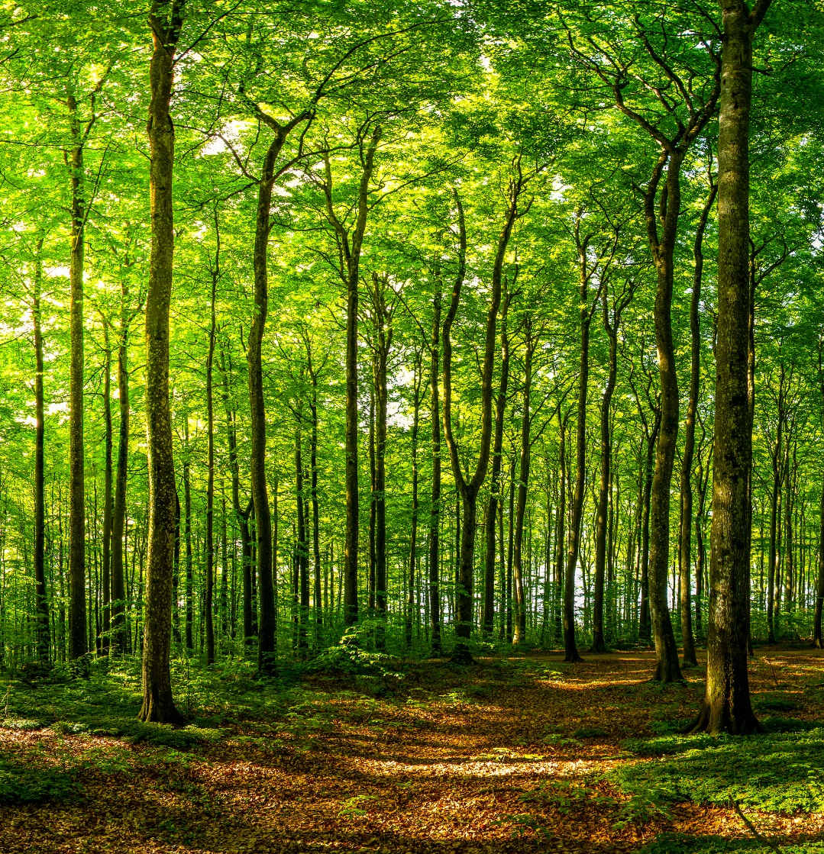
Agenda
BNG Overview
Exemptions
Validation Requirements
On-Site, Off-Site, and Statutory Credits
Significant On-Site Gain
Biodiversity Gain Plan
Guidance
Key Issues and FAQs
Questions
Notes:
Housekeeping if not undertaken, e.g. toilets, fire alarm etc

Slide 3






Biodiversity Net Gain (BNG)
(for everyone!)
Notes:
-Complicated
-Mandatory
-Process

Slide 4
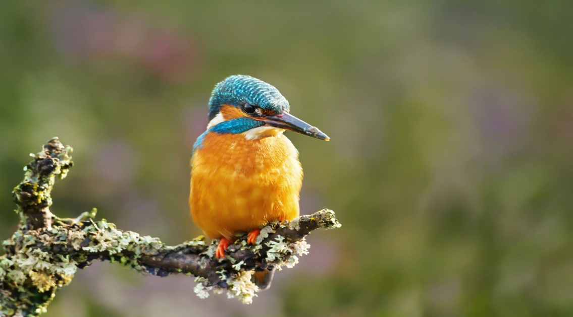
~ a concept that aims to ensure that habitat for wildlife is left in a measurably better state than it was before development
Biodiversity Net Gain
Environment Act 2021 (Sch. 14)
Amends TCPA 1990 (Sch. 7A)
NPPF 2024
Statutory Requirement (England)
  12th February 2024 – majors
  2nd April 2024 – minor/small sites
Mitigation hierarchy still applies
BNG is additional to and does not replace existing wildlife legislation, policy, and guidance
Notes:
NPPF – para 187(d)
187. Planning policies and decisions should contribute to and enhance the natural and local environment by:
(d) minimising impacts on and providing net gains for biodiversity, including by establishing coherent ecological networks that are more resilient to current and future pressures
Biodiversity Gain Hierarchy
Sets out a list of priority actions in the following order:
On-site biodiversity gains should be considered first
Followed by registered off-site biodiversity gains (through purchase of biodiversity units)
As a last resort – biodiversity credits

Slide 5
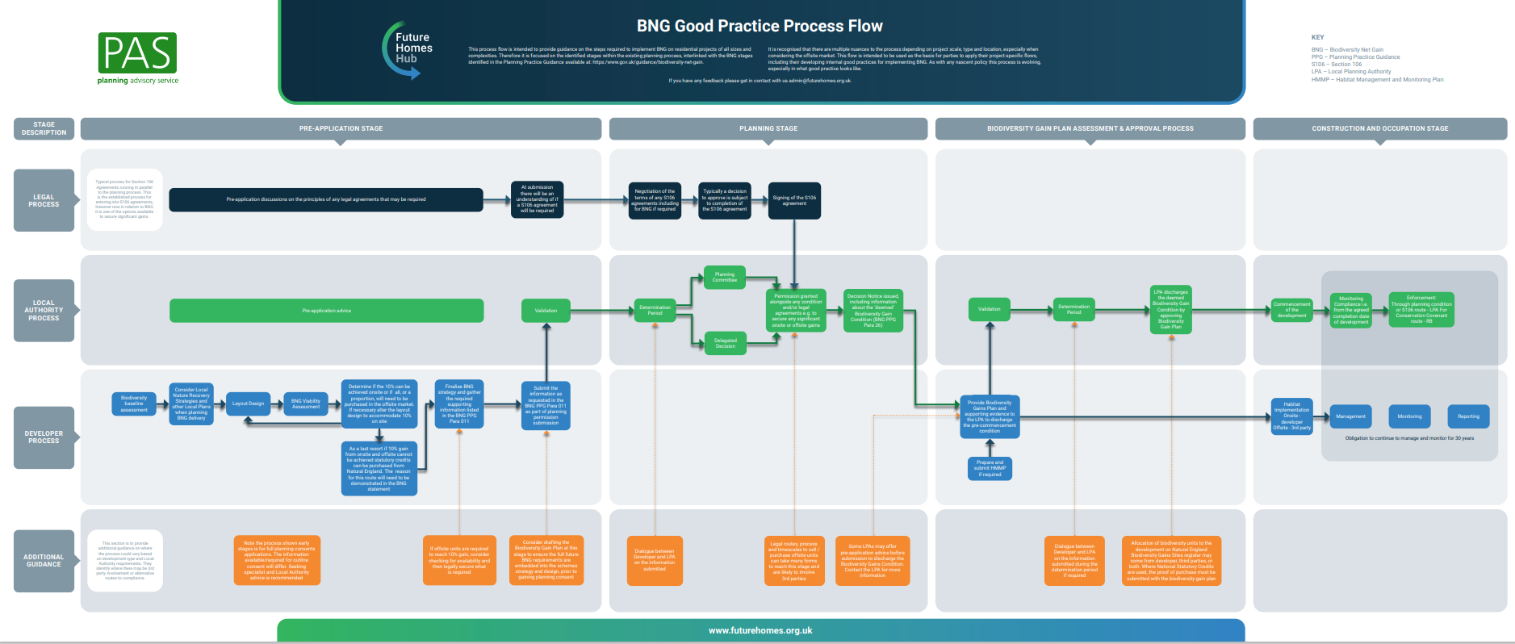
The Process
Notes:
Future Homes Hub UK

Slide 6
Stage 1
Pre-planning
Stage 2
Planning / determination
Stage 3
Post-determination
Stage 4
Construction / operation
Notes:
-Not 20% in Reg 19 Local Plan policy for majors
-BNG Pre-app advice coming soon

Slide 7
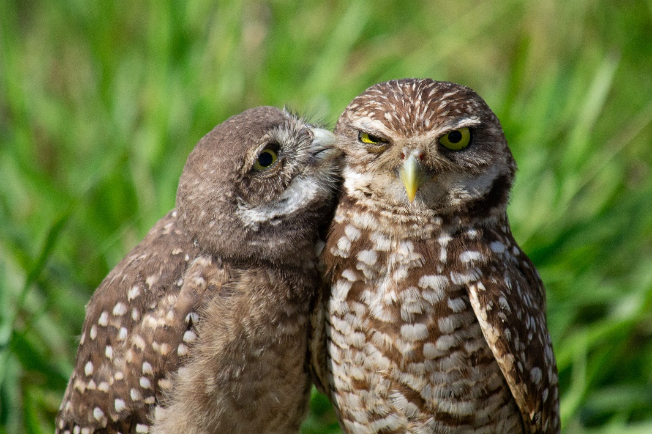
The Process – Main Points
Consider BNG from the earliest stage of the project
Design team approach – involve ecologist early in the process
Pre-App Advice Service
Biodiversity gain objective – 10%* increase in biodiversity units post development
*Draft East Devon Local Plan requires 20% BNG for major developments*
Notes:
-Not 20% in Reg 19 Local Plan policy for majors
-BNG Pre-app advice coming soon

Slide 8
The Process – Main Points
Statutory Biodiversity Metric (Main and SSM), User Guide, condition assessment sheets – Statutory Instruments (SI)
Submission of Biodiversity Gain Plan (BGP), post consent
Biodiversity Gain Hierarchy – material consideration
Approval of BGP to discharge the pre-commencement condition
Notes:
Avoiding adverse effects to very high, high and medium ‘distinctiveness’ habitats
Mitigating these effects where they cannot be avoided
Compensating for adverse effects on on-site habitats in order of priority:
1. enhance on-site habitat,
2. create new on-site habitats,
3. secure local off-site BNG provision via the allocation of registered off-site gain and
4. finally, as the last resort, the purchase of statutory credits

Slide 9
Main Metric vs Small Sites Metric
Main Statutory Metric
Must be completed by a competent person * should be an ecologist or other suitably trained/experienced professional
Habitat distinctiveness ranges from very low to very high
Habitat condition assessment undertaken by an ecologist using Defra condition assessment sheets
Offsite section tabs available
Small Sites Metric
Can only be used for ‘small sites’
Must be completed by a competent person * does not have to be an ecologist BUT should be suitably trained/experienced
Habitat distinctiveness ranges from very low to medium
Habitat condition in automated for baseline and proposed habitat creation/enhancement
No offsite sections – off-site units can still be allocated
Cannot be used if priority habitats or European protected species present on site
Notes:
Principle No1 of the 9 principles that inform the use of the metric
Small sites
No more than 9 dwelling on 1 ha or less. If number of buildings is unknown, then site area is <0.5 ha
Commercial development where floor space <1000 sqm or total area is less than 1 ha

Slide 10

Exemptions
De minimis
  ~impacts <25m² of habitat
  ~impacts <5m of linear habitat
  ~no priority habitat affected
Self-build and custom build
  ~no more than 9 dwellings,
  ~no larger than 0.5ha
Zero biodiversity value sites
  ~no vegetative habitat, only sealed surface
Retrospective planning permissions
  ~ made under s73A
Householder
Biodiversity Gain Sites
Permitted Development, e.g., Class Q
HS2, Crown Development
Notes:
-Bare ground has a value
-BNG is applicable to any impact that will result in a material change to the habitat type or condition over 30 years.

Slide 11
National Validation Requirements
Information submitted via Planning Portal Application Form
  BNG exempt or not
  Baseline biodiversity value on the date of application
  If an earlier date, provide reasons
  Description of any habitat degradation
  Biodiversity metric used and publication date
    Statutory Biodiversity Metric or Small Sites Metric
    Publication date: 29/11/2023 or 12/02/2024
  Irreplaceable habitat description

Slide 12
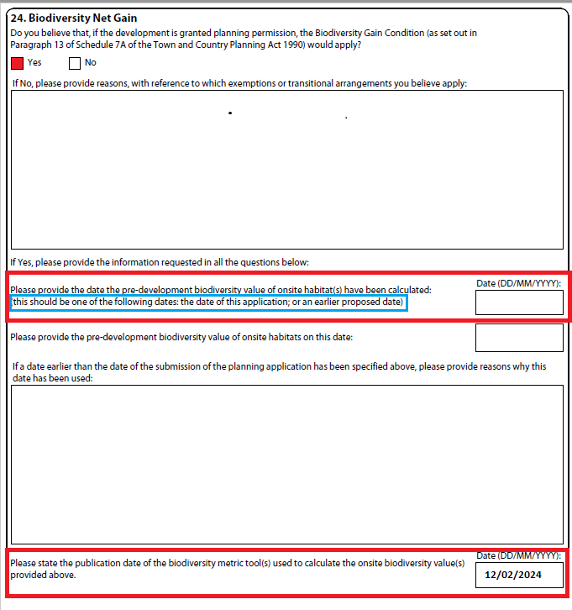
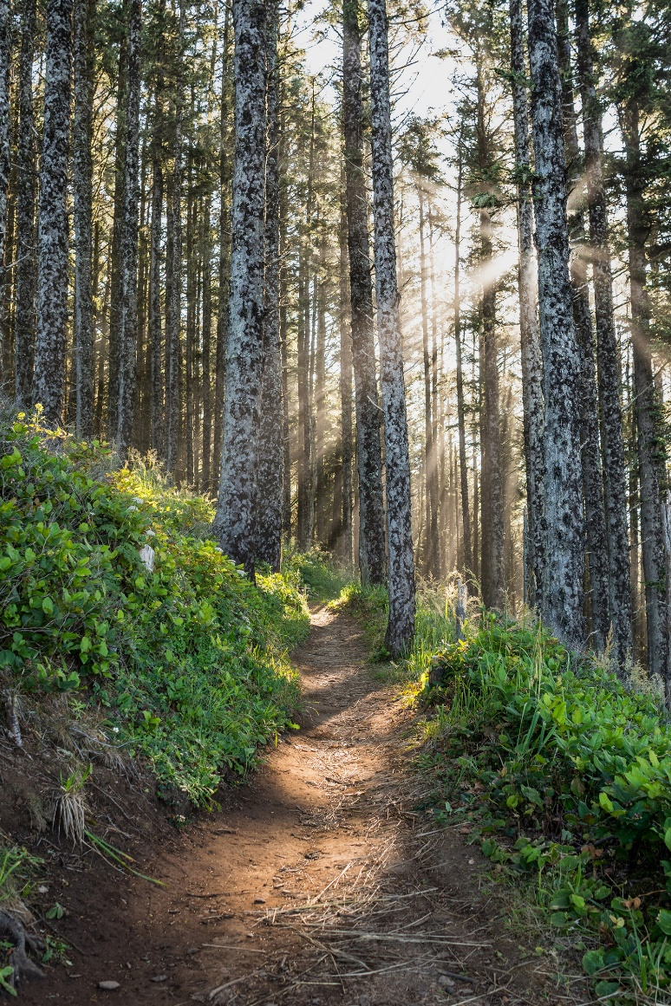

Slide 13
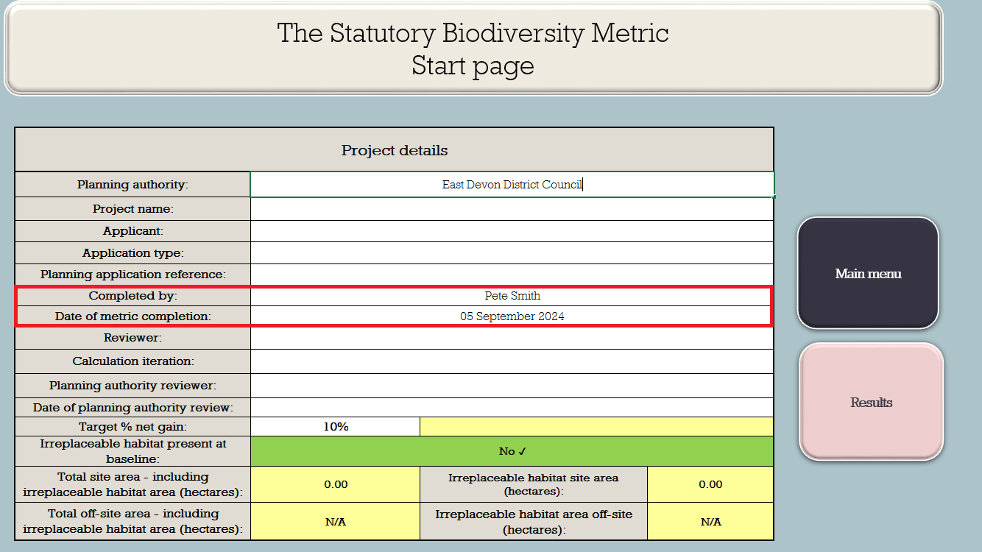
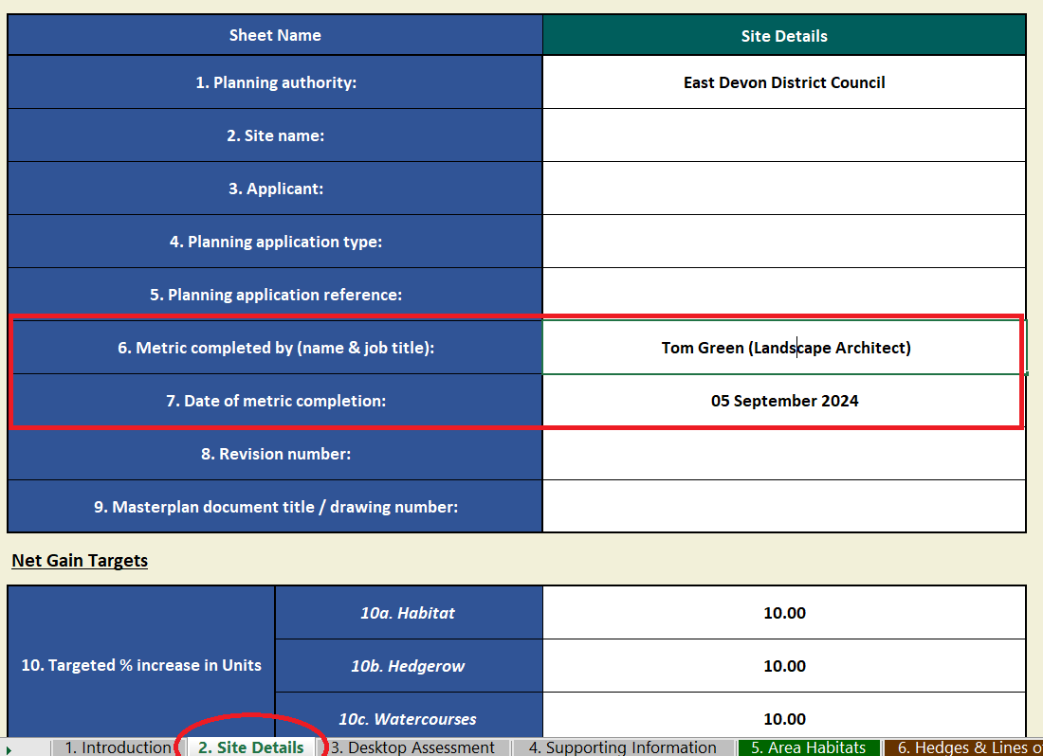
National Validation Requirements (cont’d)
Statutory Biodiversity Metric/Small Sites Metric
Submitted in excel format, (not .pdf)
Name of person completing the metric
Date of metric completion
Baseline calculations
Condition assessment sheets (for SBM only)

Slide 14
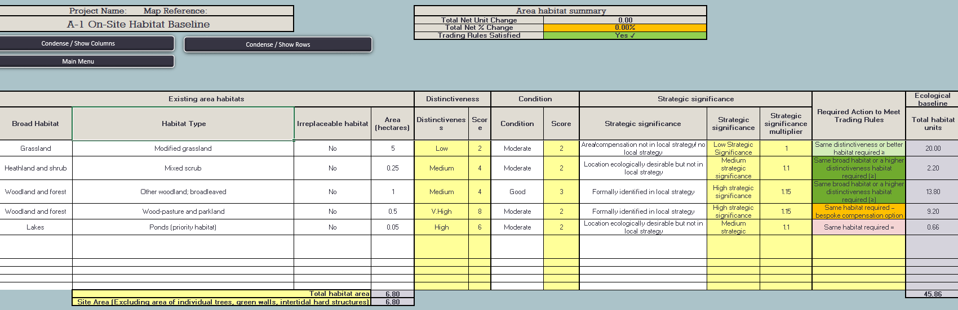

Slide 15
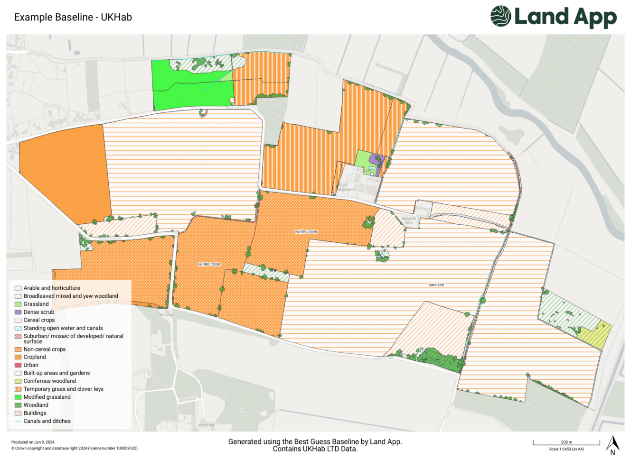
National Validation Requirements (cont’d)
Baseline Habitat Plan/Drawing
All onsite habitats existing on the date the baseline biodiversity value was calculated
UK Habitat Classification methodology preferred, with all habitat parcels identified and cross referenced with the metric reference number
An identified scale and direction of North
Including any irreplaceable habitat

Slide 16

Additional Documentation
Mainly for larger developments and for small sites with ‘significant onsite gain’
Can help provide a clearer picture
Will allow for a timely consideration before determination
BNG Statement Form – DCC website
Draft metric showing post-development intervention values (could be indicative for outline applications)
Draft Biodiversity Gain Plan – using Defra template
Draft Habitat Management and Monitoring Plan – using NE template*
BNG Assessment Report
Any other information that will help the LPA determine the application
* Use is optional but strongly encouraged
Notes:
Draft HMMP is only when the development has significant on-site gain, or as a developer you are supplying your own off-site habitat creation/enhancement. If using a HB, they will provide the HMMP to the LPA.

Slide 17
On-Site Gains vs Off-Site Gains
Make on-site biodiversity gains as a developer - GOV.UK (www.gov.uk)
Make off-site biodiversity gains as a developer - GOV.UK (www.gov.uk)
On-Site Gains
The biodiversity gain objective is met with all habitat enhancement and creation included within the red line site boundary
May be subject to a planning condition, as well as a legal agreement
Off-Site Gains
If not possible to achieve all the BNG on-site, off-site biodiversity units can be delivered through new habitat creation/enhancement on land holdings or via habitat banks
Biodiversity Gain Site Register
Subject to legal agreements only, not planning conditions
Notes:
Off-site biodiversity unit providers (habitat bank, landowner, developer, etc) must be registered on the biodiversity gain site register

Slide 18
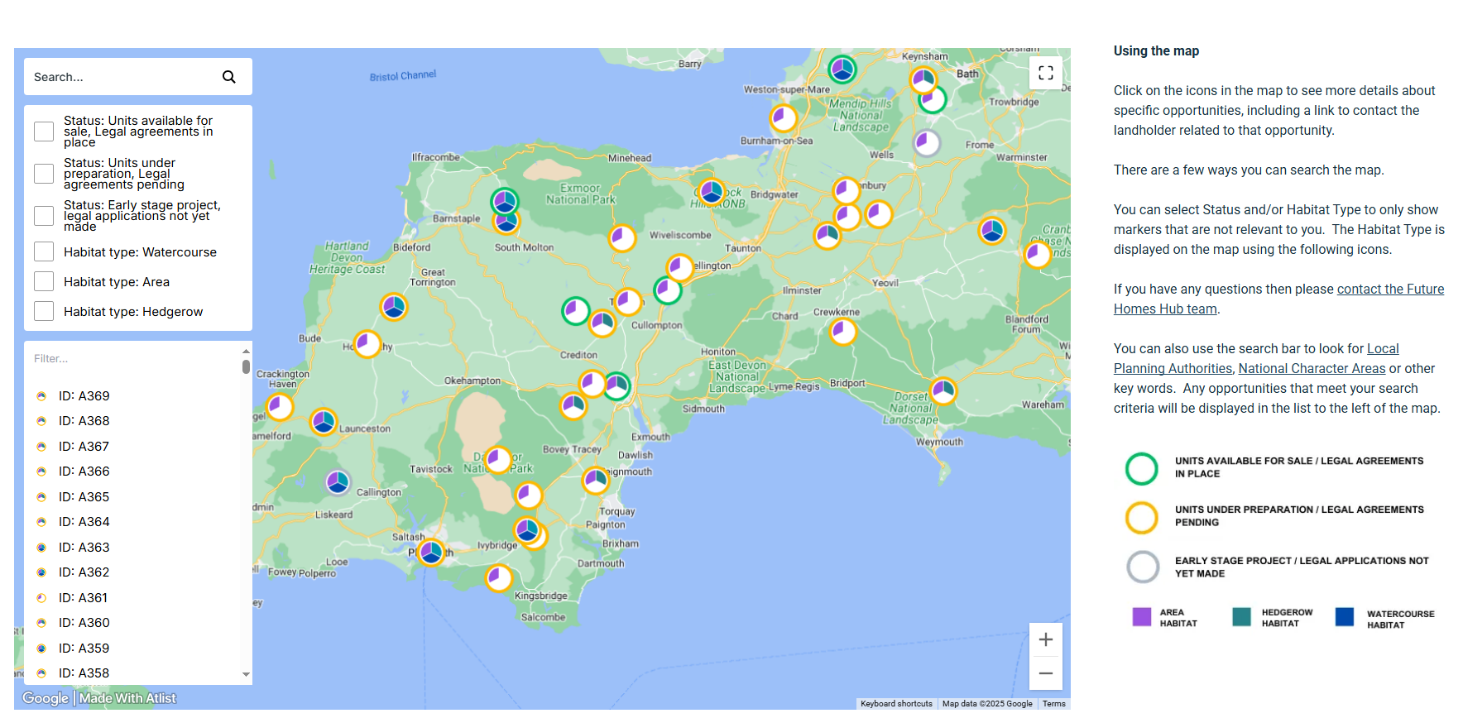
Habitat Banks
Notes:
Areas of land managed to deliver biodiversity units to offset developments

Slide 19

Statutory Credits
The ‘unit shortfall summary’ tab in the metric will show the number of credits required
A credit is worth 0.5 biodiversity units – you must buy 2 statutory credits for every 1 biodiversity unit required
They are non-refundable – only purchase when ready to submit Biodiversity Gain Plan
Only as a last resort
If BNG cannot be achieved on-site or off-site, statutory credits must be purchased from Natural England
Statutory biodiversity credits - GOV.UK (www.gov.uk)
Notes:
Evidence: developers must provide evidence they have approached 3 local or national suppliers, HB, etc, with no offsite options available
Exception: if need less than 0.25 units, evidence as above not required

Slide 20

Significant On-Site Gain
Make on-site biodiversity gains as a developer - GOV.UK (www.gov.uk)
Defined as areas of habitat enhancement which significantly contribute to the development’s biodiversity net gain relative to the value before development
Secured by either a planning condition, s106 agreement or conservation covenant for at least 30 years after the completion of the development
Requires a Habitat Management and Monitoring Plan (HMMP)
Additional information required at application stage (draft HMMP, draft Biodiversity Gain Plan, legal agreement HoT)
Notes:
* For on-site BNG, the 30 year maintenance period starts when the development is complete

Slide 21
Types of Significant Enhancements
Criteria 1
Onsite creation, enhancement, or retention, of habitats assigned medium distinctiveness or higher in the Statutory Biodiversity Metric, will be considered as significant.
Criteria 2
The onsite creation or improvement in condition of low distinctiveness habitats (excluding units delivered from by vegetated gardens), will be considered significant, where:
    the combined number of units delivered is equal to or greater than 0.5
Exceptions:
Where a medium distinctiveness habitat target condition is no greater than moderate and the post-development value is < 0.5 units
Where the target condition is no greater than moderate and the habitat would typically meet target condition through standard management practices due to their location or where suitably protected

Slide 22
Distinctiveness Examples
Very High (8)
    Lowland meadow, wood pasture and parkland
High (6)
    Lowland heathland, traditional orchard, reedbeds
Medium (4)
    Other neutral grassland, individual trees, scrub (mixed, bramble, etc), other woodland; broadleaved
Low (2)
    Modified grassland, vegetated garden, bare ground, cereal crops
Very low (0)
    Developed land; sealed surface, artificial unvegetated; unsealed surface
Notes:
-The number in brackets is the score the metric assigns to that habitat type
-Talk about strategic significance also

Slide 23

Biodiversity Gain Plan (BGP)
Completed BGP required for all relevant development
Submitted in writing no earlier than 1 day after planning permission granted
Must be approved by the LPA prior to commencement of development

Slide 24
Biodiversity Gain Plan Checklist
  Biodiversity net gain - GOV.UK (www.gov.uk)
  Completed Statutory Biodiversity metric
  Pre-development and post-development plans
  Compensation plan if development impacts irreplaceable habitats
  Biodiversity net gain register reference numbers if purchasing off site units
  Proof of purchase if purchasing statutory biodiversity credits
  Final versions of all supporting documents that accurately reflect the Biodiversity Gain Plan submitted – HMMP (if applicable), Metrics and Reports

Slide 25
Guidance
Planning Practice Guidance
    ~the ‘go-to’ webpages
Biodiversity net gain - GOV.UK (www.gov.uk)
Local guidance on EDDC website
Biodiversity Net Gain - East Devon
Devon County Council guidance on DCC website
Wildlife and geology planning guidance - Environment (devon.gov.uk)
Good Practice Principles and Best Practice Guidance (CIEEM, CIRIA & IEMA, 2016 and 2020)
Biodiversity Net Gain: Good Practice Principles for Development, A Practical Guide. | CIEEM
Notes:
EDDC website:
Periodically updated
Detailed information regarding Monitoring and fee structure forthcoming

Slide 26
BNG Key Issues
Submitting incorrect information at validation
Missing condition assessment sheets
Applicant using land within blue line boundary for on-site gain
Not all habitats within RLB recorded in baseline tab of metric
Metric Rules – Rule 2 (must deliver 10% independently for area, hedgerow and watercourse modules)
De minimis exemption
Temporary Impacts
Realistic and achievable habitats
  Medium trees, i.e., 30+ cm DBH at time of planting
  Lowland meadow, very rare and hard to maintain in a development setting
  Can be maintained for 30+ years
Notes:
De minimis - The de minimis exemption only applies to development if the following two conditions are met:
the development must not impact on any onsite priority habitat; and
if there is an impact on other onsite habitat, that impact must be on less than 25 square metres (e.g. less than a 5m by 5m square) of onsite habitat with a biodiversity value greater than zero and on less than 5 metres of onsite linear habitat (such as a hedgerow)
Onsite habitat is impacted by the development if it is lost or degraded such that there is a decrease in the biodiversity value of that habitat (as determined by the statutory biodiversity metric).

Slide 27
Nutrient Neutrality Update
Local Nutrient Mitigation Fund (LNMF) Round 2
  EDDC awarded ~£4.3m to progress mitigation schemes
Nature Based Solutions (NbS) and ‘grey’ solutions
Currently setting-up governance arrangements and recruitment
Measures likely to include replacement of septic tanks with package treatment plants (PTPs) and wetlands
Time scale…TBC – check our website.

Slide 28

Any Questions?

Slide 29
Useful Resources
Search the Biodiversity Gain Site Register
Biodiversity Gain Plan Template
Habitat Management and Monitoring Plan Template
BNG Online
BNGx - digital marketplace for biodiversity units
Devon County Council BNG Statement Form
https://www.futurehomes.org.uk/
https://www.local.gov.uk/pas/environment/biodiversity-net-gain-bng-local-planning-authorities/pas-biodiversity-net-gain-bng

