Slide 1
Planning Agents Forum
27 February 2026

Slide 2

Agenda
8.30am: Doors open and breakfast
8.45am: Welcome, house-keeping and introduction from new Planning Practice and Performance Manager Tim Lethaby
9am: Update from Development Manager Wendy Ormsby including performance and LGR
9.30am: Head of Business Development at the Planning Portal, Scott Alford, on the portal’s road map for 2026
10am: Planning Policy Manager Matt Dickins on the latest developments with the East Devon Emerging Local Plan 2020-2042
10.30am: Questions and close

Slide 3
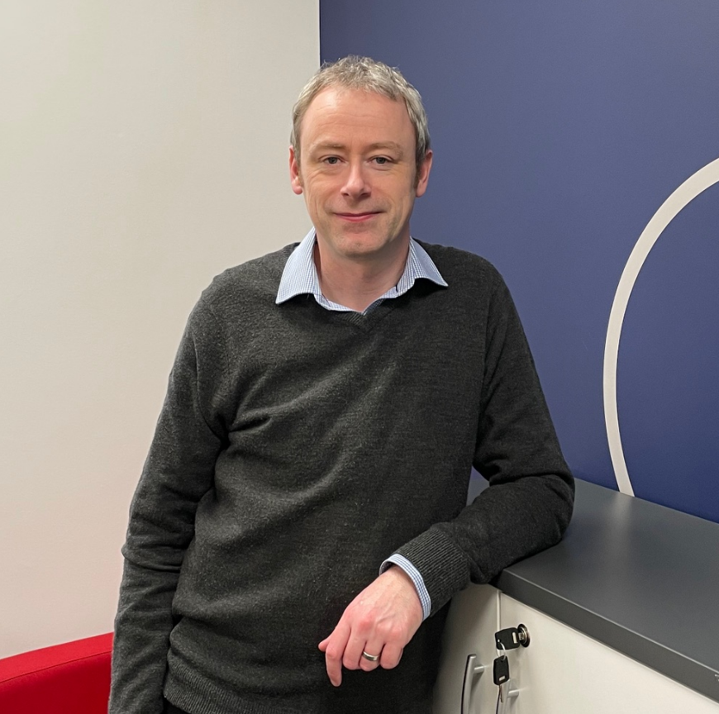
A new face in planning - Tim Lethaby
Started as new Planning Practice and Performance Manager in December
Background in Senior Management in the media industry
Extensive knowledge and experience with the planning system
West Country born and bred – know the area

Slide 4
Key aims
Build strong, positive working relationships with planning agents.
Improve the quality and consistency of planning submissions.
Drive improvements in planning performance and decision timeliness.
Support high-quality, sustainable development across East Devon.
Any questions?

