Slide 1
Town and Parish Forum
11 June 2026

Slide 2

Agenda
6pm: Doors open and coffee/tea
6.15pm: Welcome and introduction from new Planning Practice and Performance Manager, Tim Lethaby
6.30pm: Update from the Development Manager, Wendy Ormsby, on Planning and Enforcement
7pm: Update on the Community Infrastructure Levy and Section 106 by Melissa Wall, Planning Obligations Team Leader
7.30pm: Update on Local Government Reorganisation by Andy Wood, Director of Place
8pm: Questions and close

Slide 3
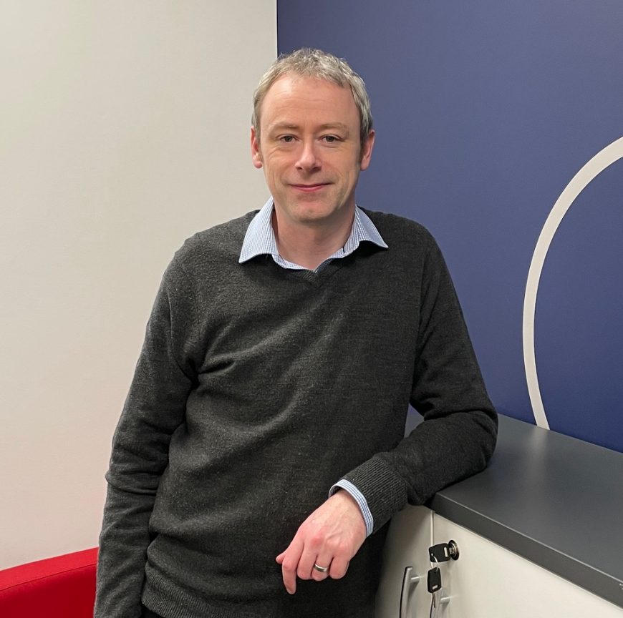
A new face in planning - Tim Lethaby
Started as new Planning Practice and Performance Manager in December
Background in Senior Management in the media industry
Extensive knowledge and experience with the planning system
West Country born and bred – know the area

Slide 4
Key aims
Build strong, positive working relationships with planning agents and town/parish councils.
Improve the quality and consistency of planning submissions.
Drive improvements in planning performance and decision timeliness.
Support high-quality, sustainable development across East Devon.
Any questions?

Slide 5
National Scheme of Delegation

Slide 6
What is it?
A new national framework setting out who decides planning applications
Introduced via the Planning and Infrastructure Act 2025
Applies to all Local Planning Authorities (LPAs) in England
Replaces locally-written schemes with a standard national approach
Key change:
Moves from local discretion → consistent national rules

Slide 7
Why is it being introduced?
Significant variation between councils in decision-making
Leads to delays, inconsistency and uncertainty
Government aims:
Faster decisions
More consistency across England
Clearer roles for officers vs councillors
Committees focusing on important cases only

Slide 8
Key principle: “Delegation by default”
Planning officers become the default decision-makers
Committees used only where justified
Shift towards professional, policy-led decisions
Committees now focus on:
Strategic
Complex
Locally significant proposals

Slide 9
Two-Tier System
Tier A – MUST be decided by officers
No committee involvement
Examples:
Householder applications
Small housing developments
Minor commercial proposals
Certificates of lawfulness
Non-material amendments

Slide 10
Two-Tier System (cont.)
Tier B – Officer-led (with possible committee referral)
Default = decided by officers
Can go to committee only if criteria met
Referral allowed if:
Significant economic, social, or environmental impact
Important planning policy issues
Key point
Committee involvement becomes the exception, not the rule

Slide 11
New “Gateway” to Committee
No automatic referral based on:
Number of objections
Councillor “call-in”
Instead:
A nominated officer + nominated councillor decide jointly on Tier 2 applications
Must meet a defined “significance test”

Slide 12
What’s changing from current system?
Before:
Each council sets its own scheme
Councillors often able to call in applications
Many routine cases go to committee
After:
National rules apply everywhere
Far fewer applications go to committee
Stronger role for planning officers

Slide 13
Impact on Parish & Town Councils
Fewer applications discussed at committee level
Greater importance of:
Early engagement
Submitting clear planning comments
Influence shifts to:
Planning policy
Local Plan / Neighbourhood Plan
Key point:
Parish views still matter—but decisions more likely made by officers

Slide 14
Timeline
2025 – Act passed
June 2026 – Guidance published
Implementation: End October 2026

Slide 15


Slide 16
Planning and Enforcement at EDDC

Slide 17
Agenda
Legal and policy background
EDDC Enforcement Policy
Enforcement process and procedure
Caseloads and resource

Slide 18
The Council’s power to take enforcement action comes from Parliament under the:
Town and Country Planning Act 1990,
The Planning (Listed Building and Conservation Area’s) Act 1990,
The Planning and Compensation Act 1992,
Town and Country Planning (Control of Advertisements) Regulations 2007,
Anti-Social Behaviour Act 2007
The Localism Act 2011.
The Community Infrastructure Levy Regulations 2010 (as amended).
Levelling-up and Regeneration Act, 2023

Slide 19
Paragraph 60 of the National Planning Policy Framework (NPPF), 2024
60. Effective enforcement is important to maintain public confidence in the planning system. Enforcement action is discretionary, and local planning authorities should act proportionately in responding to suspected breaches of planning control. They should consider publishing a local enforcement plan to manage enforcement proactively, in a way that is appropriate to their area. This should set out how they will monitor the implementation of planning permissions, investigate alleged cases of unauthorised development and take action where appropriate.

Slide 20
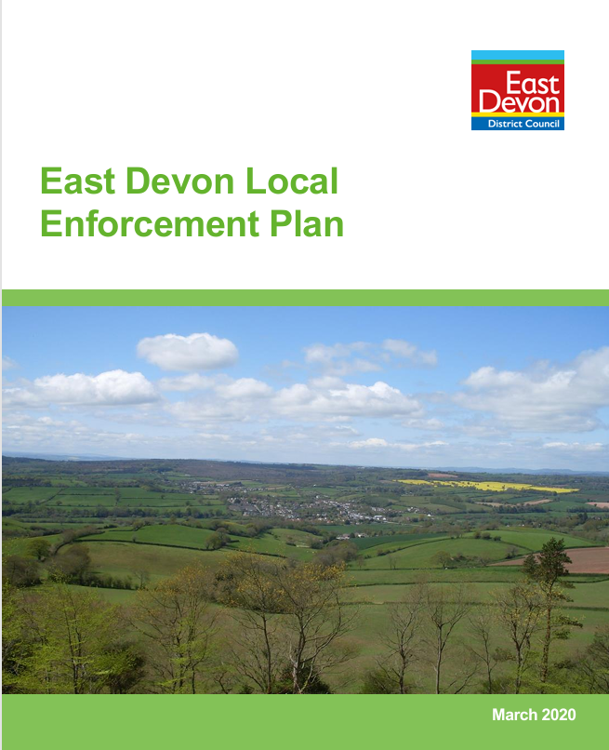
East Devon Local Enforcement Plan, 2020
Service aims
Planning enforcement and what is a breach of planning control
Making a complaint
The assessment and decision making process : enforcement process flowchart
Planning enforcement powers available
Enforcement in relation to trees
Listed building enforcement
Breaches of s.106 legal agreements
Non-compliance with the community infrastructure levy (CIL)

Slide 21

KEY SERVICE AIMS
To strike a balance between protecting public safety, amenity and other important interests and enabling acceptable development to take place, even though it may initially have been unauthorised;
Complaints will be prioritised according to their urgency and potential harm;
Enforcement action will be taken where it is expedient to remedy harmful consequences and when it is in the wider public interest;
Ensure that any formal action is proportionate to the breach.
To remedy harm caused by breaches of planning control in the interests of protecting and enhancing the built and natural environment of East Devon and the amenity of its residents and visitors;

Slide 22
High Priority Complaints – Requiring Immediate Investigation
Development resulting in concerns for public health and safety which are controllable through planning legislation.
Works of demolition, significant alteration or extension causing substantial harm to, or total loss of, a heritage asset.
Works to protected trees (either those covered by a Tree Preservation Order or those within a conservation area), important
Demolition of important unlisted buildings/heritage assets in conservation areas. Development that may adversely affect or destroy a site of nature conservation value.
Development that has a significant impact on the natural environment.
Significant unauthorised building works/structures.
Uses and activities that cause significant disruption by reason of noise, smell, fumes or other forms of nuisance.

Slide 23
2. Medium Priority Complaints – Investigation to commence and complainant to be informed of progress within 15 working days
Changes of use resulting in harm to residential amenity or the immediate environment.
Non-compliance with conditions/planning obligations resulting in harm to residential amenity or where there is less likelihood of substantial harm to significant trees and hedgerows.
New build and other works within conservation areas not covered under A. above.
Where immunity from enforcement action due to the passage of time will come into effect shortly.
Other works causing less than substantial, or no, harm to the significance of a heritage asset.
Other Operational and building works

Slide 24
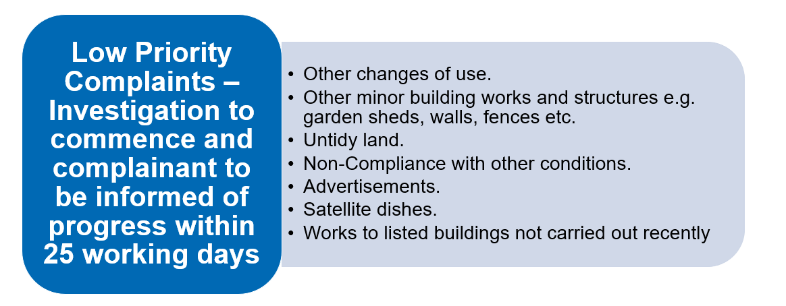

Slide 25
Time limits for taking enforcement action
Previously:
Within 4 years of substantial completion of the construction of a building;
Within 4 years for an unauthorised change of use to a single dwelling;
Within 10 years for any other breach including breach of a planning condition.
Now changed (Section 115 of the Levelling-up and Regeneration Act, 2023)
10 years for all breaches that were not immune from enforcement action on 25 April 2024.

Slide 26
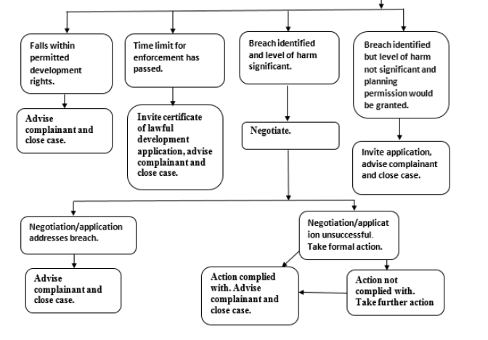

Slide 27

Planning Enforcement Powers Available:
Planning Contravention Notice
Enforcement Warning Notice
Enforcement Notice
Breach of Condition notice
Stop Notice
Temporary Stop Notice
Untidy Land Notice – Section 215
Non- compliance with Enforcement Notice or BCN:
Court Action, subject to availability, nature and strength of evidence and whether the public interest is served
Injunction
Direct Action (usually a last resort)

Slide 28
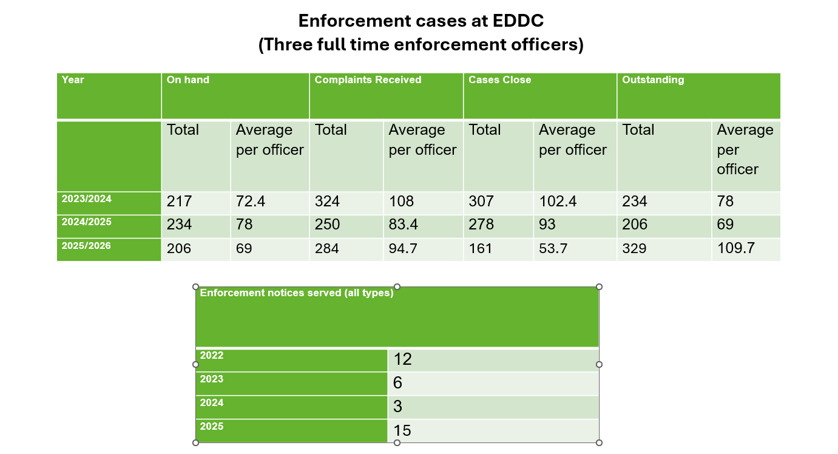

Slide 29
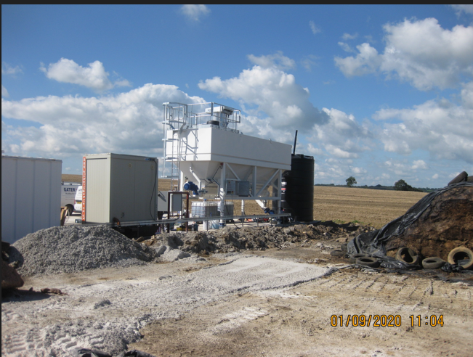
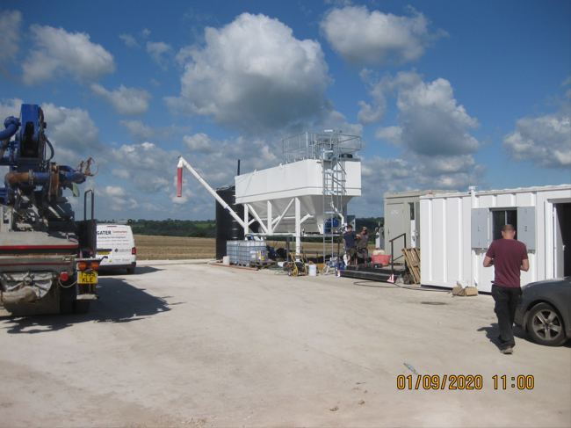
Case Study: Stopgate Farm, Yarcombe, Honiton – unauthorised use and development of land to provide a concrete batching plant.

Slide 30
Time Line
20/8/2020 Complaint received from a member of the public
1/9/2020 Site visit by enforcement officer who observed an unauthorised concrete pad with a new concrete production unit and business
8/10/20 Letter sent to landowner advising the development should be removed or a retrospective application submitted.
9/12/2020 Further letter sent.
2/2/2021 Final letter sent advising that enforcement proceedings would commence if no response.
25/3/2021 Planning application received to retain the cement silo, water silo, site office and concrete pad
3/12/2021 Application refused.
9/5/2022 Enforcement notice served requiring removal all of plant and ceasing of use, with 6 months to comply from date notice takes effect.
11/5/2022 Appeal submitted against the enforcement notice and the refusal of planning permission submitted to PINs.
7/2/2023 Appeals dismissed.
6/10/2023 Site visit confirmed the notice had been complied with and case closed.
      3 year time scale

Slide 31
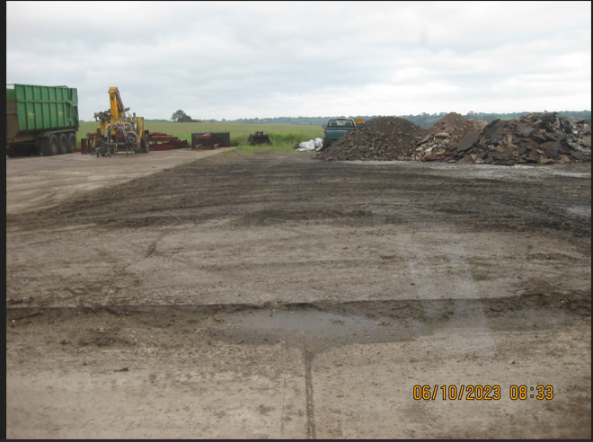

Slide 33
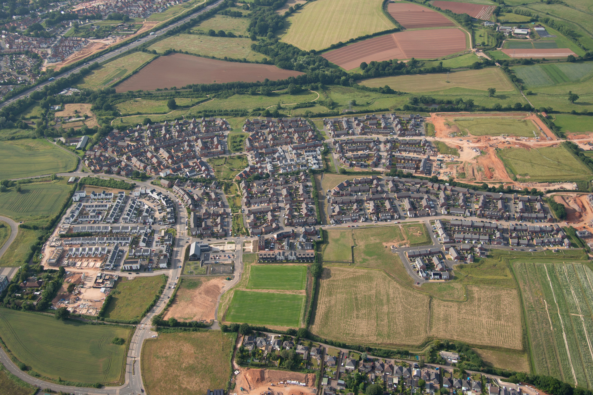

Planning Obligations
S106 & CIL
Briefing
June 2026

Slide 34

Planning Obligations meet the team
Melissa Wall
Team Leader (S106 officer)
Vacant
S106 Officer
Carolle House
CIL Officer
Vacant
CIL Officer
George Paddon
Support Officer

Slide 35
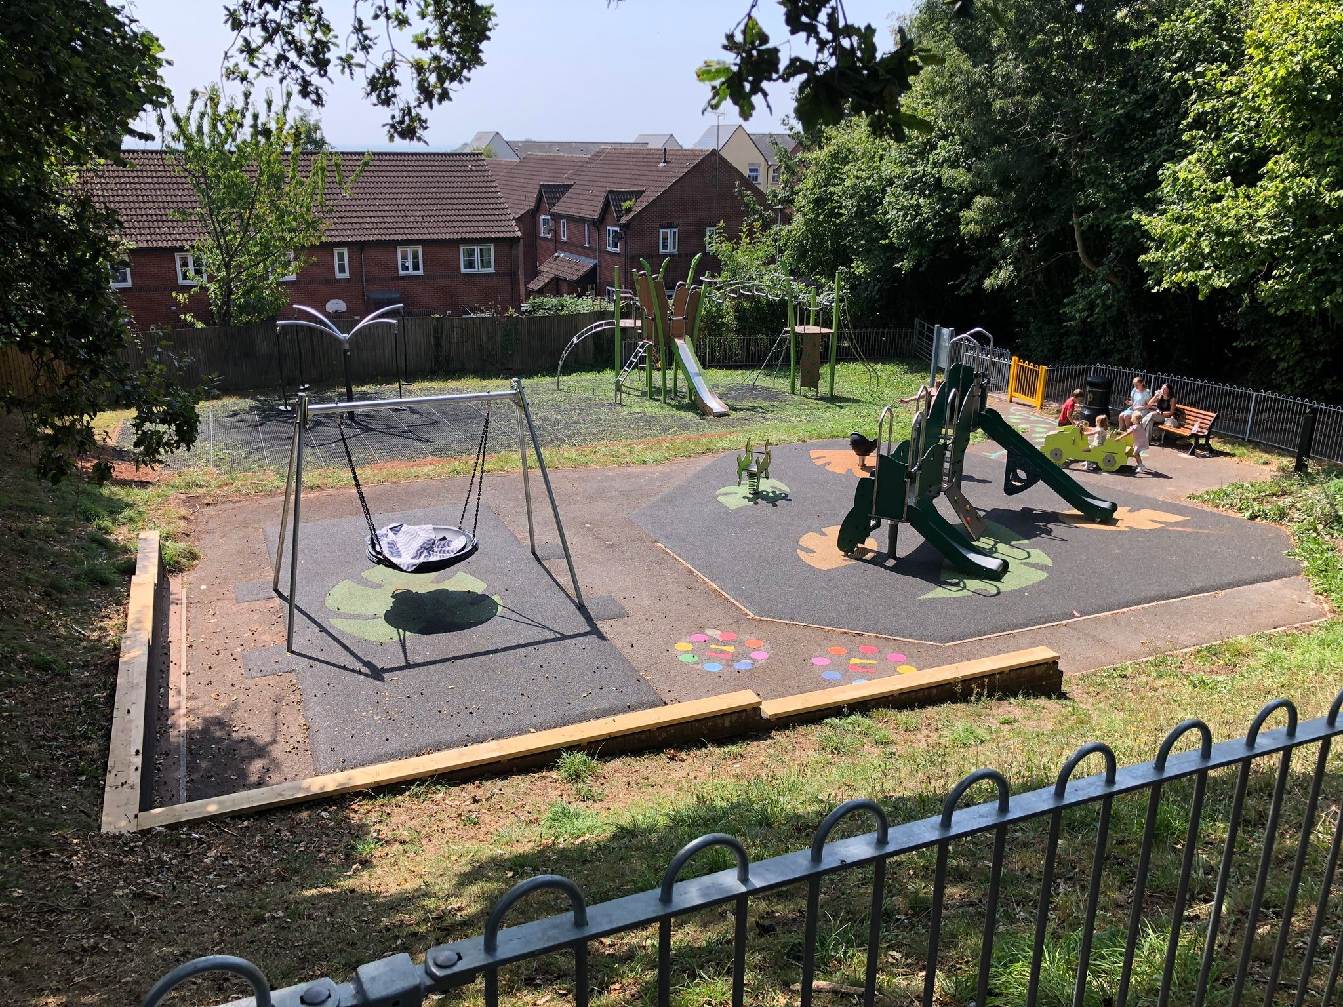
Planning Obligations: what we do
Collect contributions
Administer CIL exemptions
Monitor triggers for payment
Advise on spending
Liaise with Town & Parish Councils
Maintain records
Report
Mitigate the impact of development on the community
Help to deliver community infrastructure

Slide 36
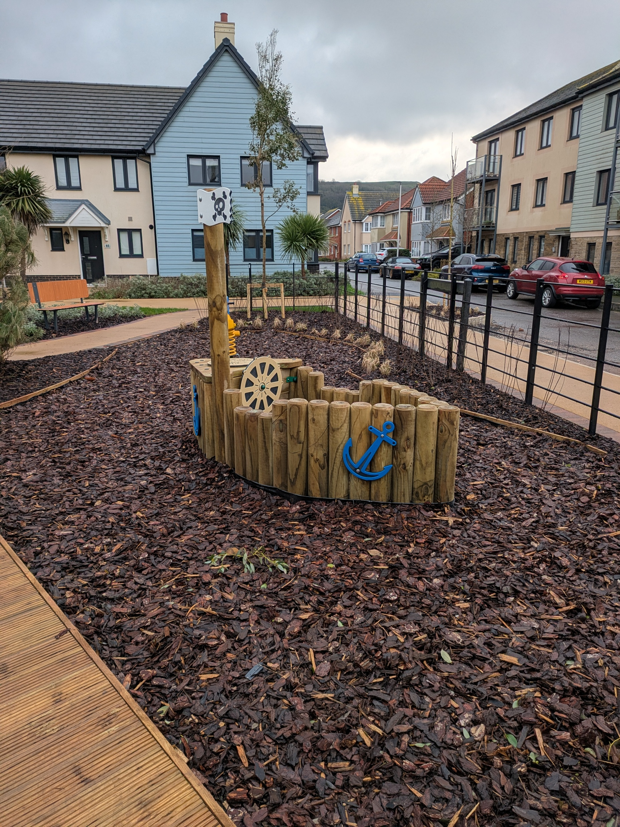
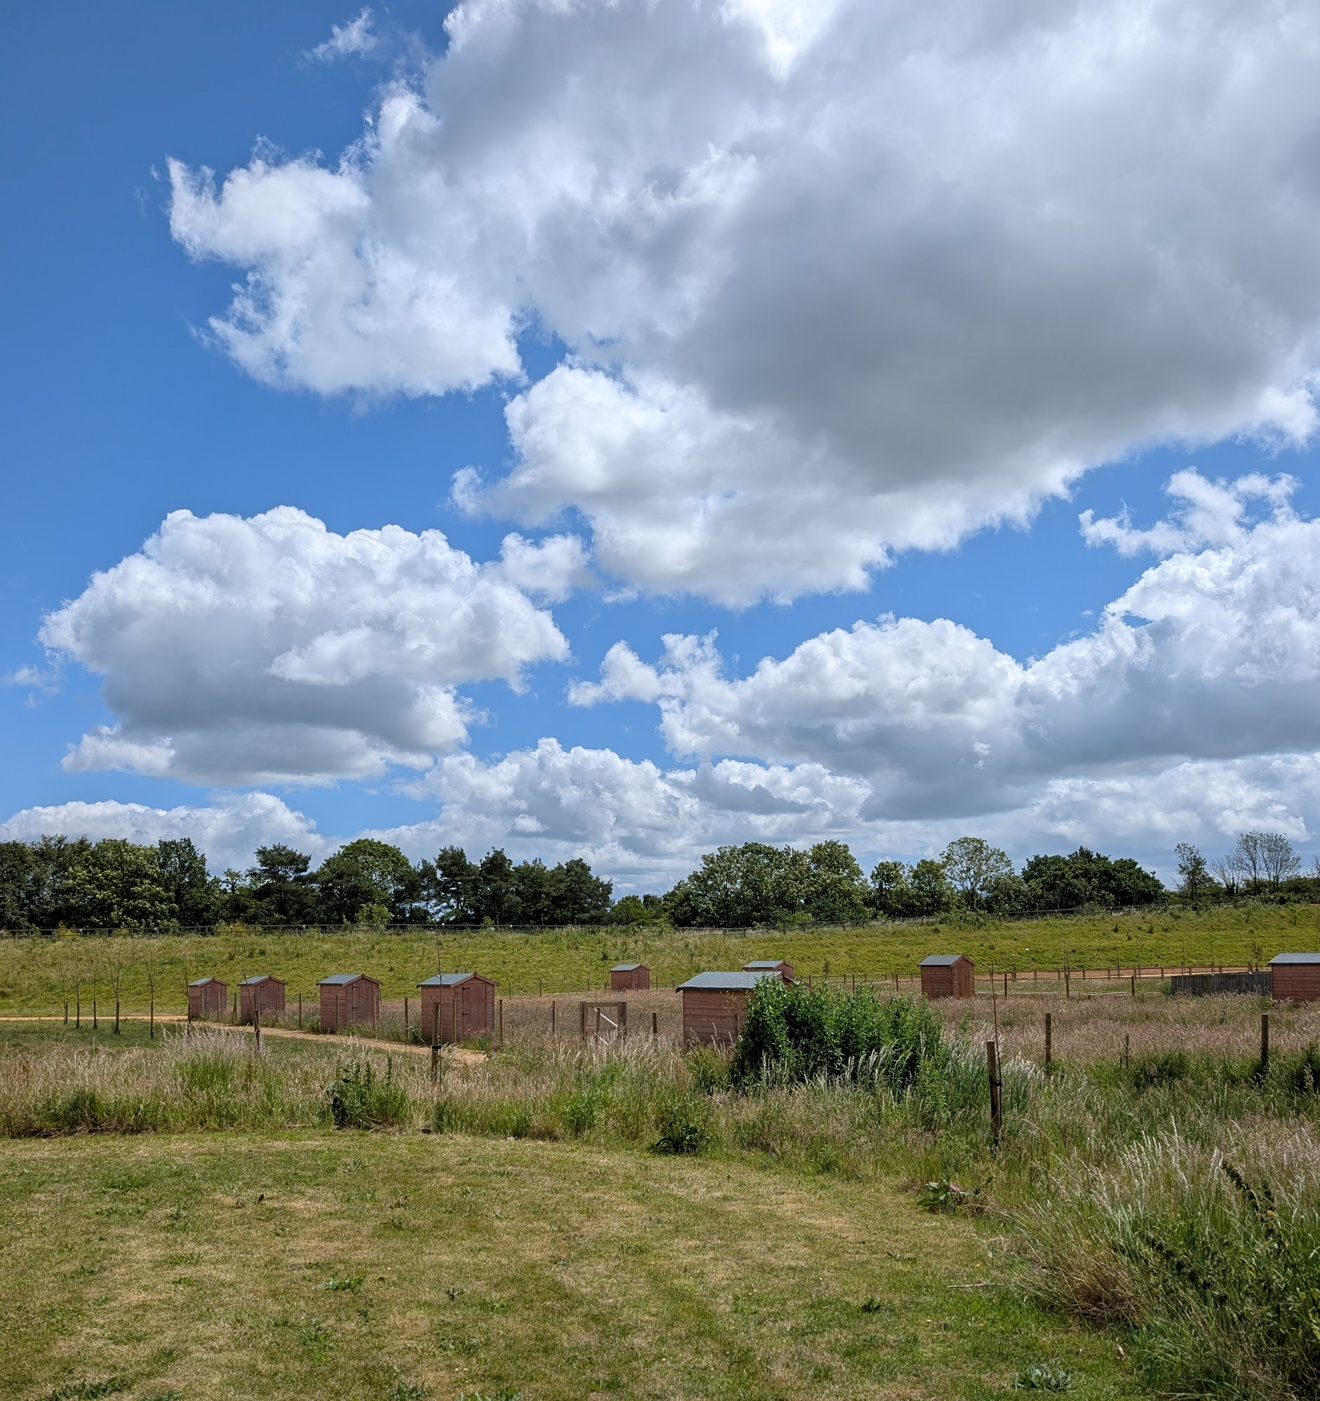
Planning Obligations: s106 in east devon
What do we secure through Section 106 agreements?
Affordable Housing
On-site open space & play
BNG
Habitat mitigation
Highway works (DCC)
On-site SUDs/Drainage
Reminder
We no longer seek contributions towards off-site open space, and this is now covered by CIL & NCIL.
Management Companies
Cabinet report ‘Stewardship of Public Amenities’ 30 July 2025 & Competition and Markets Authority Housing Market Study February 2024 – Management Company dissatisfaction. EDDC looking at alternatives with a potential role for Parish Councils
Stewardship+of+Public+Amenities.pdf
S106 agreements – include an option to transfer open space, allotments and play areas to the Parish Council instead of going to Management Companies. BNG & cost implications.

Slide 37
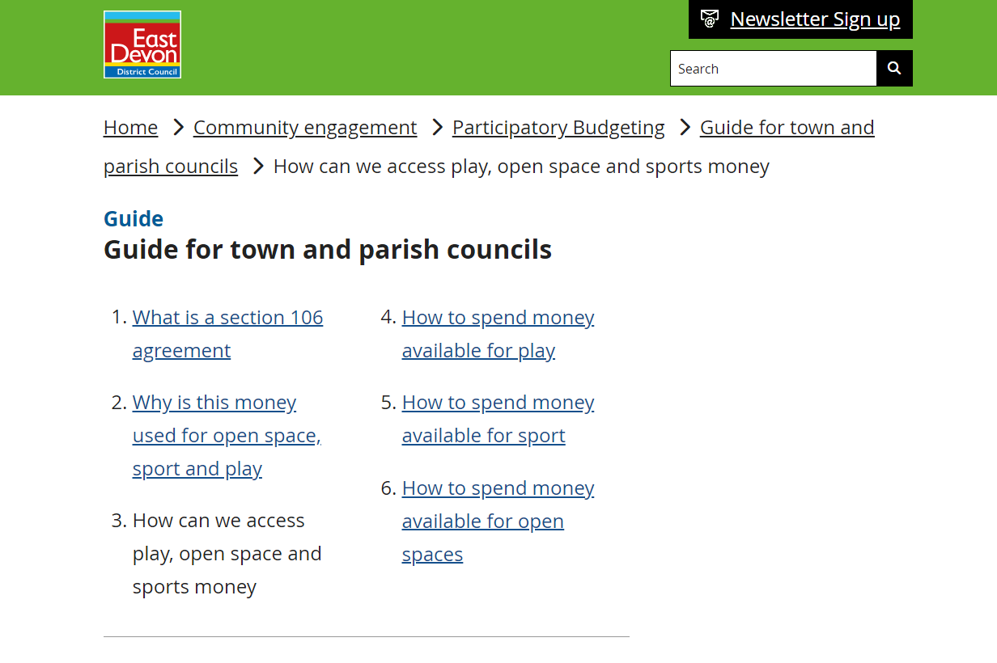
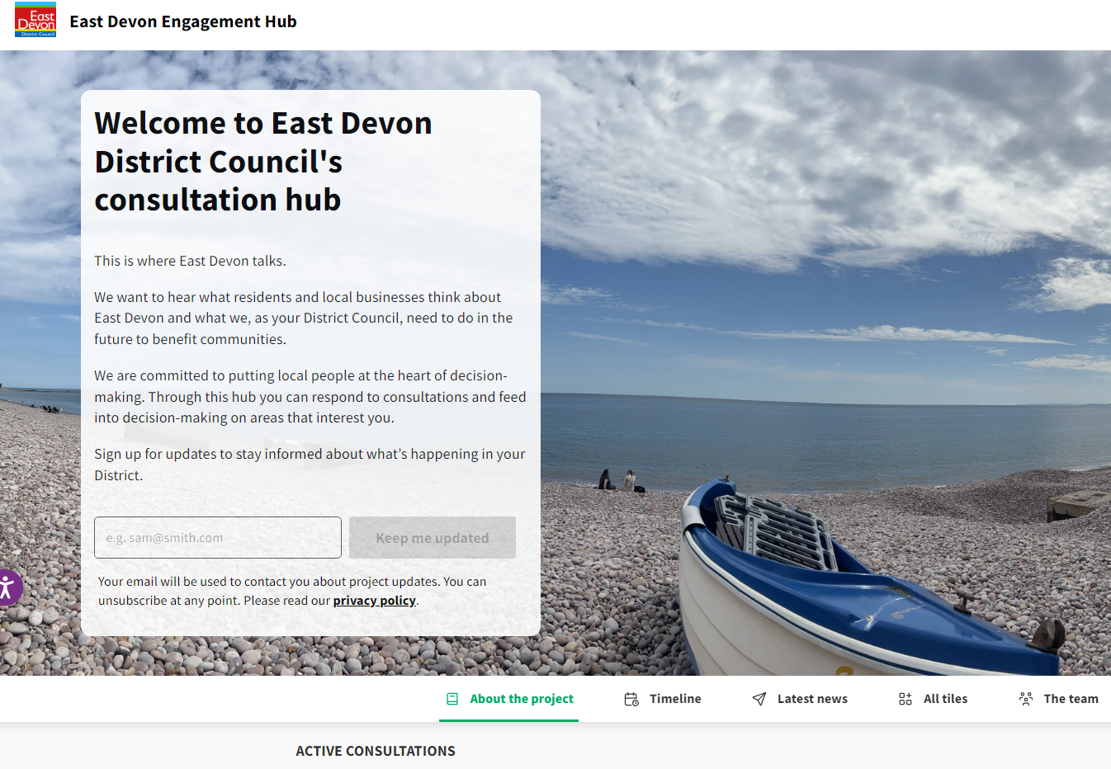
spending s106 open space monies
There are still some Parishes with small amounts of S106 open space monies
Keen to get these monies spent before LGR
East Devon are unique in that we allow Town & Parish Council’s to have a say on spend
Please contact S106@eastdevon.gov.uk

Slide 38
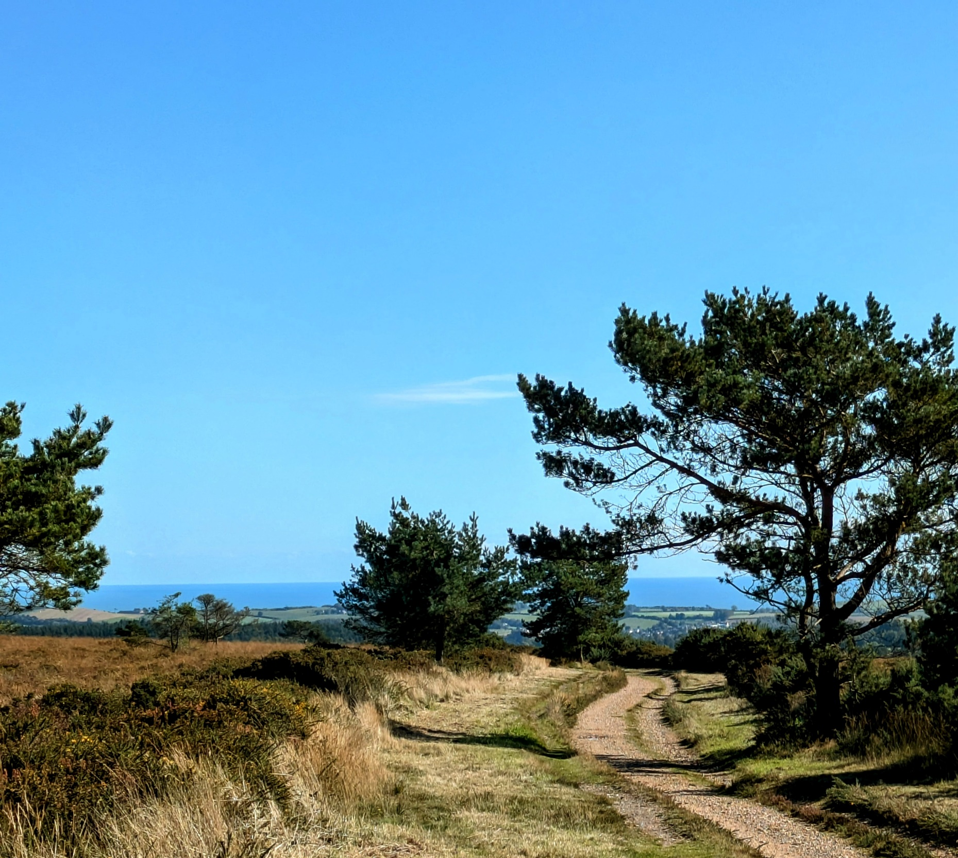
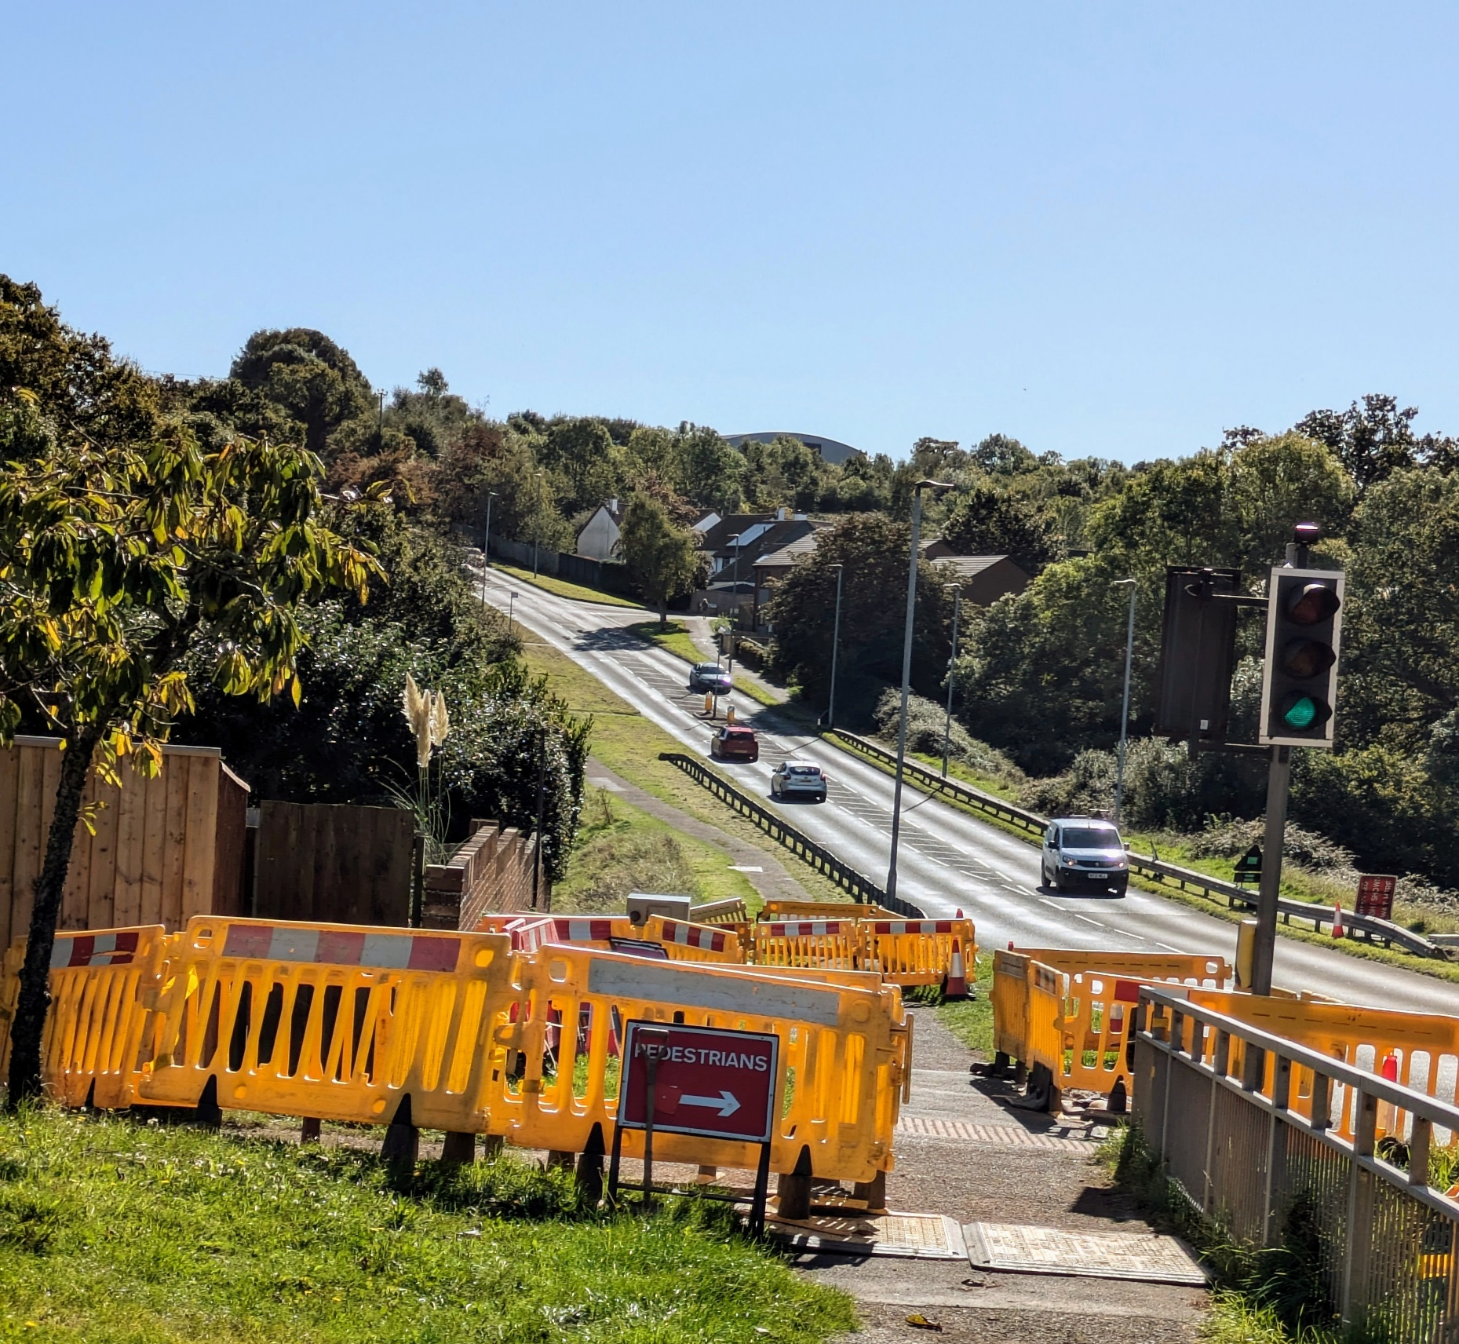
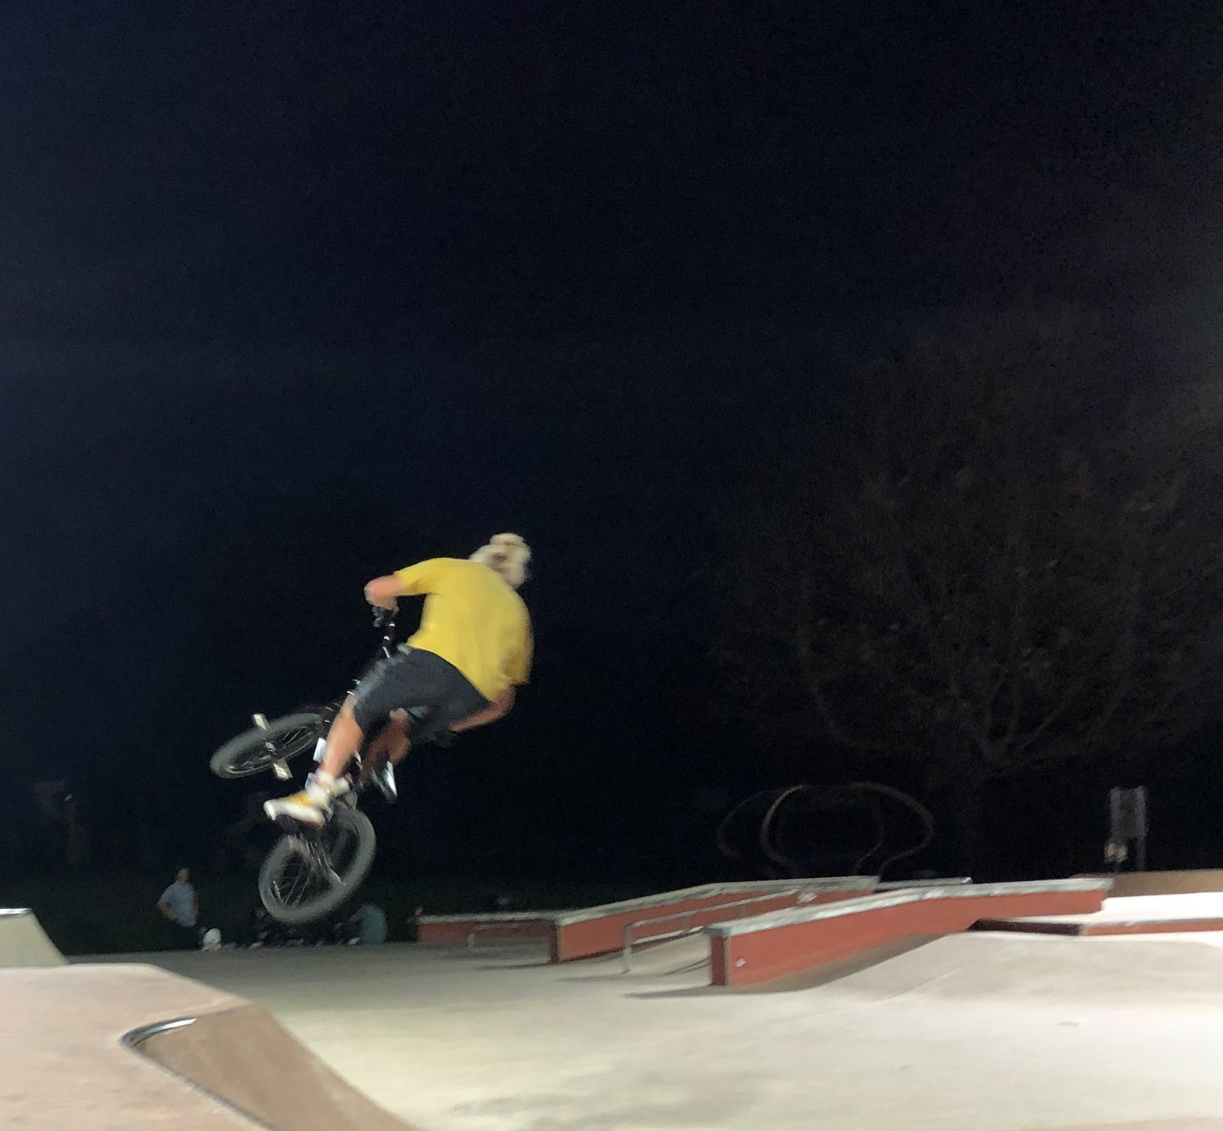
Planning Obligations:
CIL Split
Neighbourhood CIL
15% of CIL Collected or;
25% if Town or Parish has a made neighbourhood plan
Sent to Towns and Parishes twice yearly in April and October
Available for spend on by the town or parish once received
CIL Infrastructure Fund
For spend on large scale strategic infrastructure anywhere within East Devon
Spent through a bidding process
8.6% of this fund is dedicated to Habitat Mitigation
CIL Admin Fund
Up to 5% of CIL collected is spent on the team monitoring costs
Unspent costs are transferred into the CIL Infrastructure Fund if not needed

Slide 39
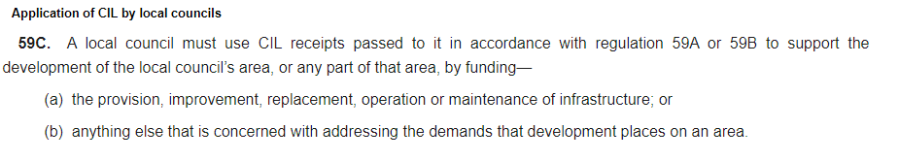
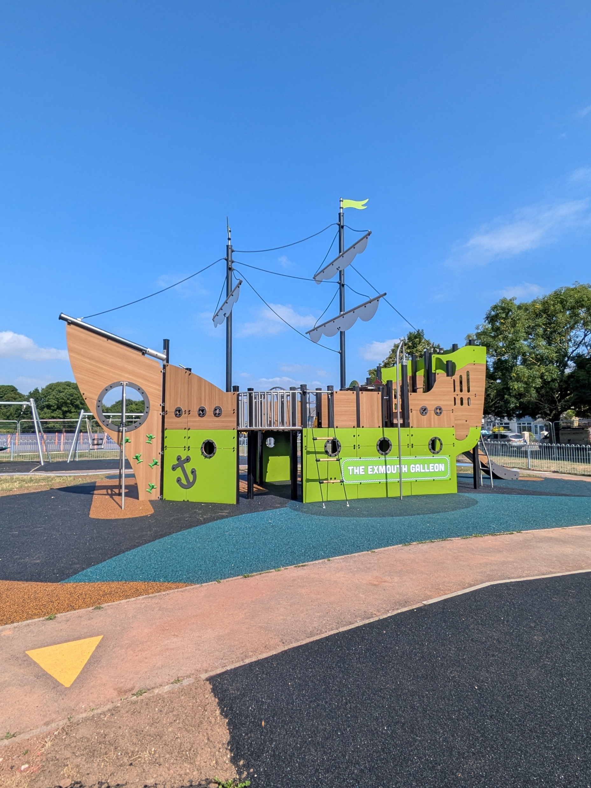
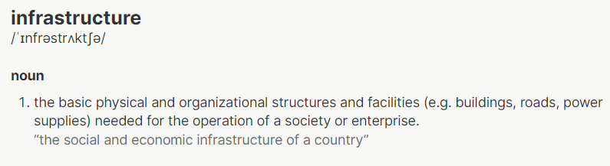
Planning Obligations: spending Neighbourhood CIL
Can be spent by Towns and Parishes once received without input from EDDC
Regulation 59C allows for spending on a wide range of things
Good practice to consult with community for spend
Please notify the Planning Obligations Support Officer when spend is made so our records and public facing module stay up to date

Slide 40
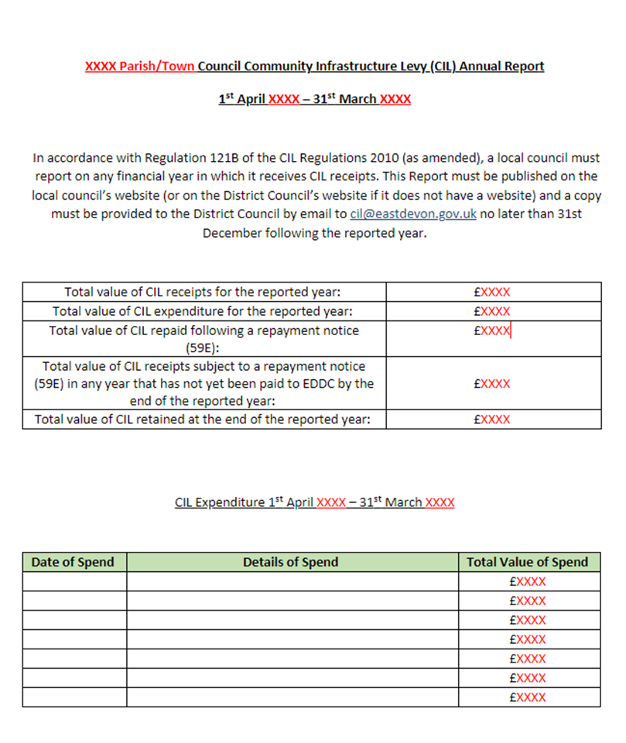
Planning Obligations: Reporting on CIL
5 year spend limit for Neighbourhood CIL and under the CIL regulations we can ask for unspent NCIL back.
EDDC produce an Infrastructure Funding Statement every year
Parish and Town councils are required to report on CIL receipt and spend if this has occurred within the financial year.
Guidance on our website on spending NCIL
Community Infrastructure Levy (CIL) - Parish and Town Council – CIL Payments - East Devon

Slide 41
Planning Obligations: spending Neighbourhood CIL: infrastructure delivery plan
Existing Infrastructure Audit
What do you have, who owns it, quality, capacity of the infrastructure
Think about growth and allocated sites in ELP
What pressure is new development going to place on your community
Community Engagement and meeting the needs
How will you engage and with who? Start to identify infrastructure requirements
Proposed NCIL spending to support new development
Projects should reflect the previous steps
Should meet the pressures on existing infrastructure
Timescales for delivery and priority rating
Understand the wider strategic infrastructure requirements, EDDC IDP, Playing Pitch Strategy
Can be a stand-alone document or as part of your Neighbourhood Plan. If you review your Neighbourhood Plan, think about producing an IDP

Slide 42
Enforcement of CIL & S106
You are our eyes and ears in your communities and know what is going on.
Monitoring CIL exemptions is time consuming as the information is not always readily available.
If you know a development has commenced on-site – let us know so we can check our records.
If you are aware someone is letting out a recently built annex this could be a disqualifying
S106 obligations generally have triggers for when they have to provide something
How can you help us monitor and enforce obligations?

Slide 43

Planning Obligations: questions

Slide 44
Local Government Reorganisation
11th June 2026

Slide 45
Welcome & introductions

Slide 46
Overview
The English Devolution White Paper was published in December 2024
Local proposals were submitted in November 2025
Government consultation on the five options took place in Spring 2026
Decision expected by 16th July 2026

Slide 47
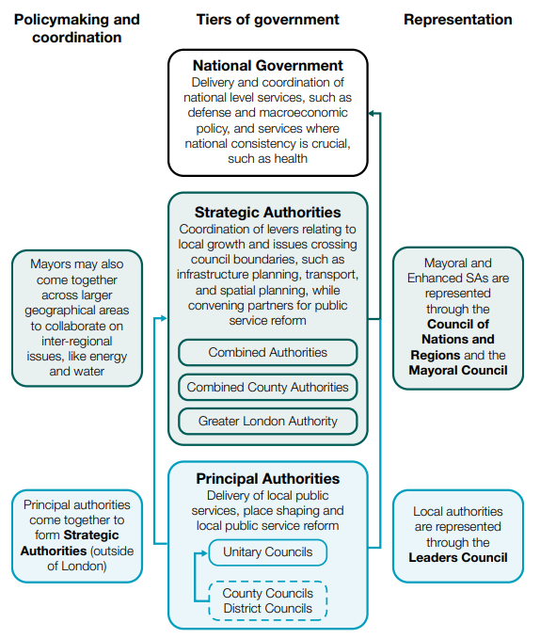

Slide 48
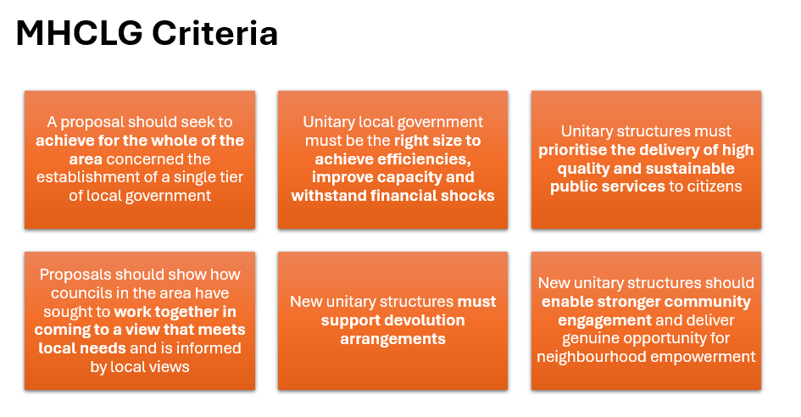

Slide 49
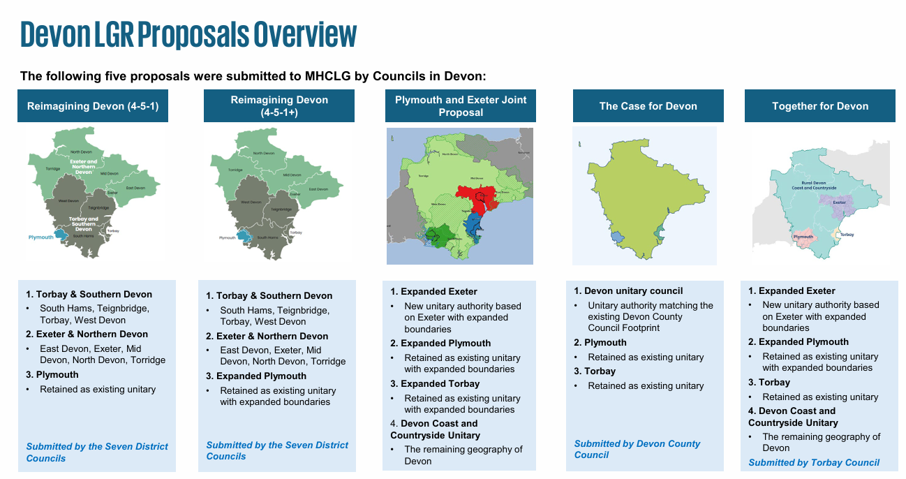

Slide 50
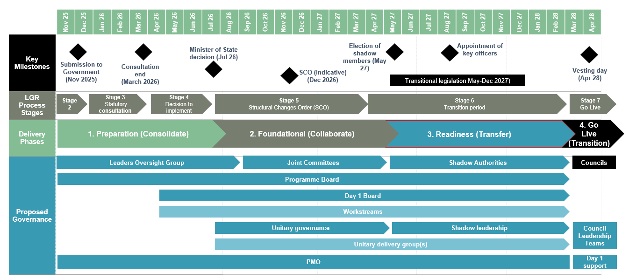
The road to vesting day

Slide 51
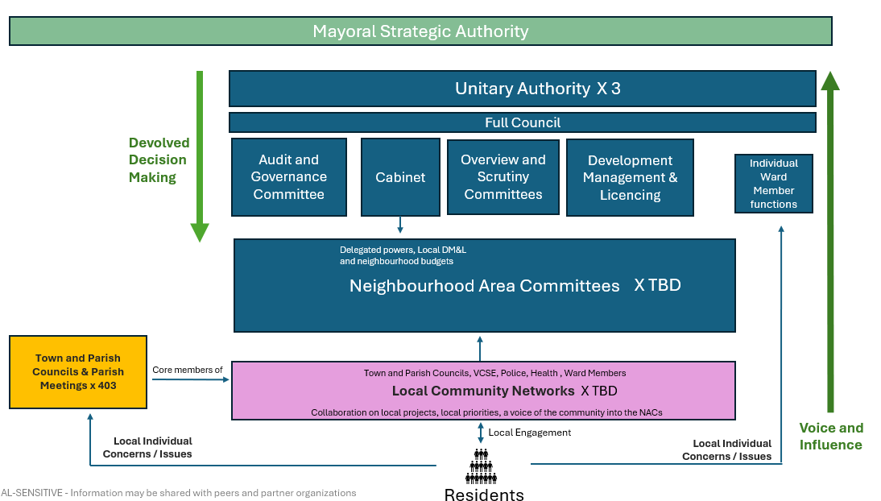

Slide 52
Key points
Increasing pace of activity and formality of governance arrangements
July decision will enable focus on implementing the preferred option
Shadow authorities will;
  Review and revise implementation plans
  Undertake decisions on staffing, budgets, operating models and policy
  Make substantive appointments

Slide 53
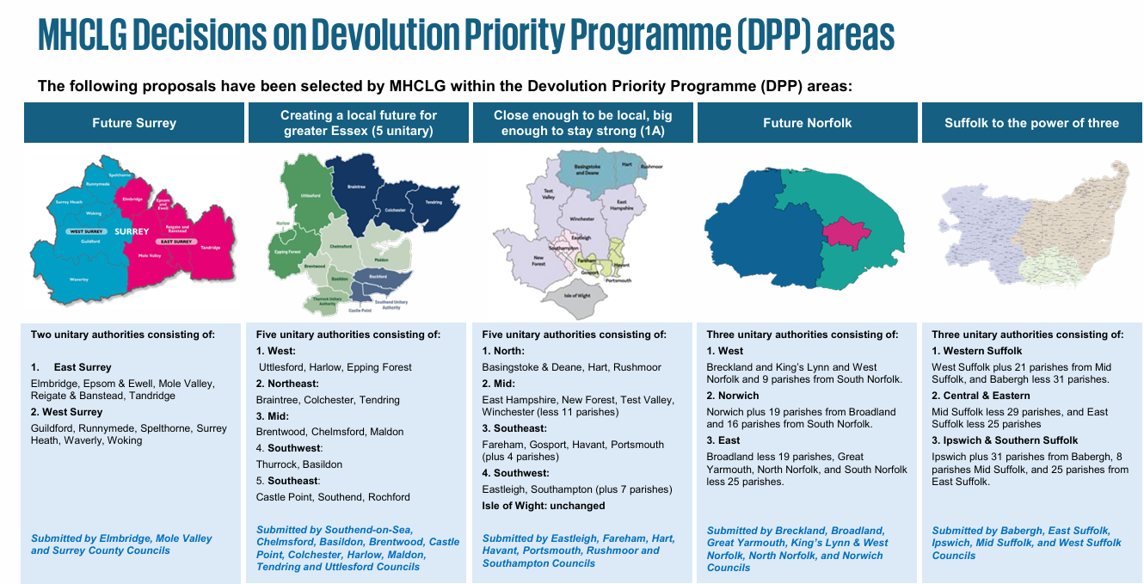

Slide 54
Key aspects
Decisions to date do not set a precedent
Trend towards a larger number of smaller unitaries < 500k population guideline
Examples of existing District areas being split particularly when proximate to larger urban areas
Further consultation re: East/West Sussex

Slide 55
Next steps
Decision expected by mid July
Focus on implementation and transition
Proposed warding arrangement mid August
Structural Change Order due by March 2027
Elections to shadow authorities May 2027
Vesting day 1st April 2028. All current councils cease to exist at this point (excl Plymouth, which continues in all options)

Slide 56
Q&A

Slide 57
Any questions?
Notes:
Question 1:
When do you see us getting - or can you see us getting - to having a five-year housing supply and how does that affect us if we don't get one?
Answer:
We must have a five-year housing land supply at the point of adoption of the new Local Plan. So in the meantime we do need to bolster our housing land supply through consents. This is part of the reason why you see sites coming forward ahead of the local plan and why where those comply with the emerging policy, we're looking to support them and bring them forward early to help to bolster that supply position such that when we get to the local plan examination, we can present trajectories that demonstrate a five year housing land supply and that therefore the plan is sound and we can deliver to meet the housing needs.
We are looking to achieve plan adoption towards the end of 2027/early 2028 and the target is therefore to achieve the full 5-year housing land supply by that point – we do not realistically envisage we are going to get to a five-year housing land supply before then.
Question 2:
As presumably, this is more led-by /down to landowners and developers putting schemes forward – what happens / how it be addressed if that is not the case?
Answer:
That is a factor, but in that respect we are fortunate in the sense that East Devon is a place where there is quite high demand for housing and developers do want to bring sites forward, even in market conditions which aren’t so favourable. In the last couple of years, the numbers that have been delivered have been around 600 homes per year - as opposed to the 950 that we've trying to achieve - but even so, we have seen quite significant consents coming forward in that timescale in terms of applications on sites that are allocated in the emerging plan and for the expansion areas at Cranbrook, which creating a pipeline of applications which will help to bolster our supply. We are confident that we can have reached the position we need to by the point of plan adoption, but we do not have any expectation that we will manage to do it before then.

