Slide 1
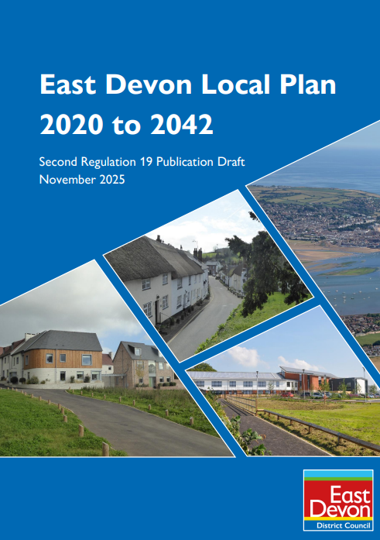
The emerging East Devon Local Plan
…. and beyond
Matt Dickins
Planning Policy Manager, EDDC

Slide 2
• The ‘rule-book’ for determining planning applications
• Sets out where new development will be allowed and restricted
• Protects our natural and built assets
• Provides homes for people to live in and places for work and leisure
• Secures affordable housing and other developer contributions
The role of the local plan – a refresher
Notes:
The local plan is effectively the ‘rule book’ – in loose terms - for determining planning applications. Its policies are used by the District Council in the planning application determination process, but also more generally for informing wider thought processes about development and initiatives across the district.
It sits alongside the National Planning Policy Framework (NPPF), neighbourhood plans, the Cranbrook plan and the Devon County waste and minerals plans. Within this bigger picture of planning documents, the local plan is focused on setting where new development will be allowed, and where development will be restricted, taking into account constraints related to protecting our natural and built assets, amongst other matters.
In so doing, the role and importance of development needs to be recognised – it being about finding places to build houses, where people will live and work, and creating leisure, recreation and education opportunities. One of the roles in doing this, is to secure developer contributions and benefits from development. A critical one of these is affordable housing, which is a very real and significant issue for East Devon, with delivery of affordable housing increasingly prominent in the conversations we have and in the feedback we receive in relation to plan preparation.

Slide 3
Until finally and fully superseded the following plans remain in place:
- the existing Local Plan;
- the Villages Plan.
The Cranbrook Plan - but some policies to be superseded in part by the new plan.
Neighbourhood Plans - our council remains very committed to supporting these plans.
Devon County Council – waste and mineral plans
The current Development Plan in East Devon
Notes:
The local plan is effectively the ‘rule book’ – in loose terms - for determining planning applications. Its policies are used by the District Council in the planning application determination process, but also more generally for informing wider thought processes about development and initiatives across the district.
It sits alongside the National Planning Policy Framework (NPPF), neighbourhood plans, the Cranbrook plan and the Devon County waste and minerals plans. Within this bigger picture of planning documents, the local plan is focused on setting where new development will be allowed, and where development will be restricted, taking into account constraints related to protecting our natural and built assets, amongst other matters.
In so doing, the role and importance of development needs to be recognised – it being about finding places to build houses, where people will live and work, and creating leisure, recreation and education opportunities. One of the roles in doing this, is to secure developer contributions and benefits from development. A critical one of these is affordable housing, which is a very real and significant issue for East Devon, with delivery of affordable housing increasingly prominent in the conversations we have and in the feedback we receive in relation to plan preparation.

Slide 4
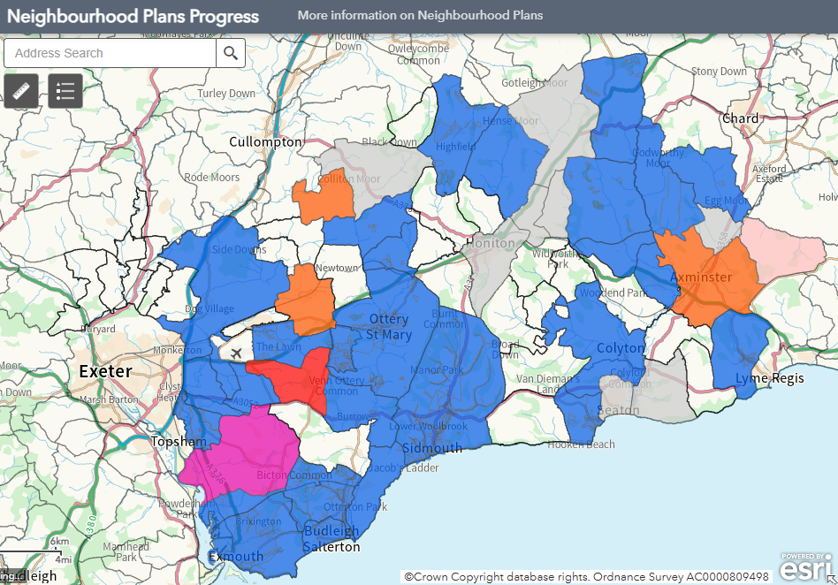
Neighbourhood plan coverage
28 plans made in East Devon (blue)
27 first plans
1 modified plan
1 at examination now
3+ new plans actively emerging
3+ undertaking reviews
Enquiries from 7 more
Notes:
There are c.1,200 neighbourhood plans in place nationally and neighbourhood planning has been very active in East Devon, which ranks as 11th in local planning authorities in England for the number of plans made.
In East Devon 28 plans have gone all the way through the process to adoption (27 first plans and we’ve now had one first reviewed and updated plans that’s gone through the modification process to adoption).
There is a continued steady stream of enquiries from communities, and several parish / town councils are committing their own budgets in the light of the funding cuts.
We are very encouraged by the continued interest in neighbourhood planning in East Devon, of which we are very supportive and wish to see continue, but at the same time, we do fully recognise the challenges of neighbourhood planning over the over recent years, in the context of the new Local Plan, coupled with the development pressures arising from the less than five-year housing land supply, and now with the cut in funding available.

Slide 5
Our work sits in context of:
2023 NPPF – against which our local plan will be Examined.
2024 NPPF – used for DM purposes and some new local plan relevance.
2025 NPPF – current consultation draft (more to be said in conclusions)
Planning and Infrastructure Act - 2025
The government / national picture
Notes:
The local plan is effectively the ‘rule book’ – in loose terms - for determining planning applications. Its policies are used by the District Council in the planning application determination process, but also more generally for informing wider thought processes about development and initiatives across the district.
It sits alongside the National Planning Policy Framework (NPPF), neighbourhood plans, the Cranbrook plan and the Devon County waste and minerals plans. Within this bigger picture of planning documents, the local plan is focused on setting where new development will be allowed, and where development will be restricted, taking into account constraints related to protecting our natural and built assets, amongst other matters.
In so doing, the role and importance of development needs to be recognised – it being about finding places to build houses, where people will live and work, and creating leisure, recreation and education opportunities. One of the roles in doing this, is to secure developer contributions and benefits from development. A critical one of these is affordable housing, which is a very real and significant issue for East Devon, with delivery of affordable housing increasingly prominent in the conversations we have and in the feedback we receive in relation to plan preparation.

Slide 6
• Government require high housing numbers (950 a year – includes a 20% ‘reduction’) and we have a clear growth agenda
• But 57% of East Devon is in National Landscape areas
• The Jurassic Coast is great but acts as a constraint
• 4,000 plus listed buildings/heritage assets
• Strains and stresses on existing infrastructure
• Need to plan for new infrastructure
For our new local plan - some big challenges
Notes:
There are some well-known big challenges in providing for development in East Devon. A critical one is the high housing numbers that we need to accommodate, meaning that in the new local plan, we're looking at an average of 950 new homes a year across the district. It should be noted that this is roughly 20% less than national standard figures now say that we need to comply with (resulting from changes to the way these are calculated introduced in 2024 with the revised National Planning Policy Framework and its updated standard method), but because we are progressing the Local Plan under a prescribed tight timescale of ‘transitional arrangements’, this allows us to go for the lower figure.
The housing numbers need to be viewed within the context of a clear growth agenda for east Devon, with a lot of growth seen in recent years, which will continue, particularly in the west of the district where there is a focal point for jobs and houses, being closer to Exeter. Where growth can be accommodated is of course also closely related to the great constraints and assets we have in the district. We know there are stresses and strains on existing infrastructure and the need to plan for new infrastructure is also part of the work allied to the new plan.
(n.b. there is an updated Infrastructure Delivery Plan (IDP) available to view in the Local Plan evidence library)

Slide 7
Up to end of 2024: Early engagement
Early 2025: 1st round formal Reg 19 consultation
Late 2025 to 26th Jan 2026: 2nd round of Reg 19 (closed – 26 Jan)
Spring 2026: Submission for Examination
Late 2026/early 2027: Oral hearing sessions
2027: Modification consultation
Late 2027: Plan adoption (or maybe 2028)
Timeline
Notes:
We are very much tied by government agendas on timing for plan making; we have a new plan making system coming in next year and so we are moving forward under the “transitional arrangements”. These place time constraints on getting the plan in place, and we see achieving this under these and sooner rather than later as really quite critical for East Devon, for various reasons.
Representations need to be received by 26th January under the current (second and final) round of Regulation 19 stage consultation. Using the transition arrangements, we are aiming to submit the plan for examination in Spring 2026. It is at that point it goes to the planning inspector(s), and they effectively take charge.
Part of the work of the Inspector(s) will be holding oral hearing sessions, where they will ask a series of questions and invite people to respond. At these sessions, people can express their views and raise their challenges, and the Council will need to justify its position.
We will have modifications through the examination process, and they will also need to be consulted on – assumed in 2027 - with plan adoption anticipated late 2027, potentially into 2028.

Slide 8
• Policies have been refined (noting feedback received)
• Factual errors corrected
• New evidence has informed policy changes
• Update to Designated Neighbourhood Area housing numbers
• Updates of Habitat Mitigation
• Updating on flooding considerations and water quality
• New emphasis on conserving and enhancing National Landscapes
• Greater emphasis on electric vehicle charging
Key changes – in the latest consultation draft
Notes:
This slide highlights key areas of change to the Plan/evidence base since the first Reg 19 stage consultation. To appreciate all changes, it is important to go into the plan document itself and look throughout.
There are various factors that have driven the changes to the plan and led to refinement / sharpening of some policies, including feedback from consultation, new evidence, and correction of factual errors in some cases.
Examples of changes are:
Designated Neighbourhood Areas housing requirement figures where we have refreshed the housing numbers (reflecting latest monitoring data and site allocations). These figures are important for local communities for neighbourhood planning purposes, as they tell you about the scale of development in your plan areas (where designated).
Habitat mitigation – further work and resultant policy changes linked to the key biodiversity sites in the district, such as the Pebblebed Heaths, for which there are very strict and definite rules that we must follow.
Electric vehicle charging - greater emphasis on this, in part a reflection of environmental concerns generally but also links into habitat concerns and particularly air quality issues.
Flooding matters / flooding considerations on water quality – new evidence informing policy and policy changes (more on this later regarding Water Cycle Study)
National Landscapes – in response to the shift in the government agenda for these protected landscapes, with more emphasis on conserving and enhancing. This does not mean they cannot be built in, but it is setting the tone of policy in terms of what development can go into NL’s, how development responds to them, and how we seek to get enhancement out of the development process.

Slide 9
What is meant by ‘Sound’ and ‘Legally Compliant’?
Local plans must be prepared in accordance with the which states that a plan is ‘sound’ if it meets the following tests (as summarised):
Positively prepared
  Meeting development needs potentially including from other authorities.
Justified
  an appropriate strategy, taking into account the reasonable alternatives, and based on proportionate evidence
Effective
  deliverable over the plan period and based on effective joint working on cross-boundary strategic matter.
Consistent with National Policy
  enabling the delivery of sustainable development in accordance with the policies in the NPPF and other statements of national planning policy, where relevant
Notes:
This final consultation is very specific in its ask - it's seeking representations on the soundness and legal compliance of the proposed plan, as required by the National Planning Policy Framework. Local plans must be prepared in accordance with the NPPF, which states that a plan is sound if it meets the following test:
Positively prepared.
Justified.
Effective and consistent with national policy in regard to compliance.

Slide 10
A West End of the district focus – the part close to Exeter
- Marlcombe – new community,
- Cranbrook and major housing schemes, and
- Substantive employment sites and land areas.
Larger scale provision at the towns – especially so:
- Axminster, Exmouth and Honiton.
Greater levels of constraint across villages and in rural areas.
Focal points for development in the new plan
Notes:
This slide highlights key areas of change to the Plan/evidence base since the first Reg 19 stage consultation. To appreciate all changes, it is important to go into the plan document itself and look throughout.
There are various factors that have driven the changes to the plan and led to refinement / sharpening of some policies, including feedback from consultation, new evidence, and correction of factual errors in some cases.
Examples of changes are:
Designated Neighbourhood Areas housing requirement figures where we have refreshed the housing numbers (reflecting latest monitoring data and site allocations). These figures are important for local communities for neighbourhood planning purposes, as they tell you about the scale of development in your plan areas (where designated).
Habitat mitigation – further work and resultant policy changes linked to the key biodiversity sites in the district, such as the Pebblebed Heaths, for which there are very strict and definite rules that we must follow.
Electric vehicle charging - greater emphasis on this, in part a reflection of environmental concerns generally but also links into habitat concerns and particularly air quality issues.
Flooding matters / flooding considerations on water quality – new evidence informing policy and policy changes (more on this later regarding Water Cycle Study)
National Landscapes – in response to the shift in the government agenda for these protected landscapes, with more emphasis on conserving and enhancing. This does not mean they cannot be built in, but it is setting the tone of policy in terms of what development can go into NL’s, how development responds to them, and how we seek to get enhancement out of the development process.

Slide 11
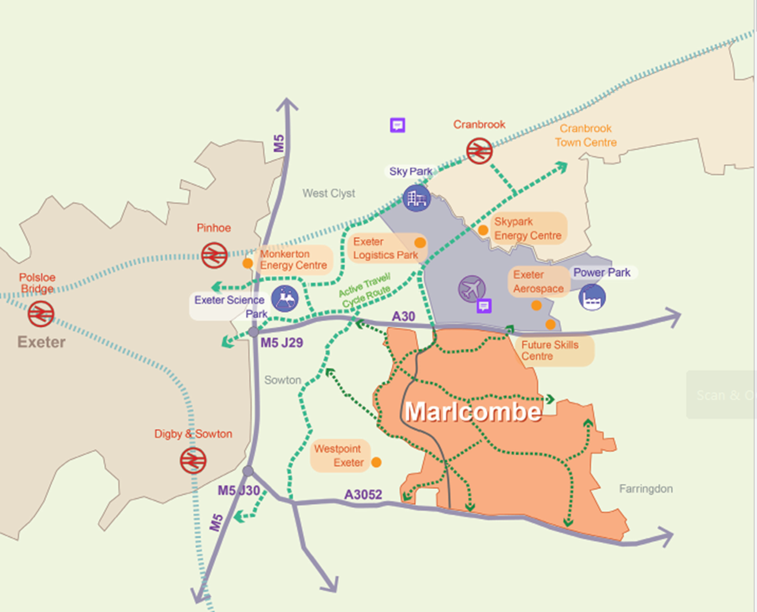
Marlcombe and the West End
• A key component of the local plan
• 3,300 new homes to 2042
• 10,000 new homes longer term
• Mixed-use high-quality development
• High levels of self containment
• Extensive work on a delivery vehicle (potential development corporation)
• Bid for Government new town programme status
Notes:
Marlcombe is the second new town for east Devon (i.e. after Cranbrook) being promoted through the plan, extending from the A30 to the north, just south of the airport, to the A3052 to the south, to boundaries with West Point in the west, and across in the direction of Farringdon in the east (but with a safeguarded area which can be seen on the master plan (overleaf)).
This is a key component of the Local Plan strategy, taking a large amount of the housing need, with 3,300 new homes planned for Marlcombe within the plan period to 2042. There is a vision within the plan for 10,000 new homes in the longer term, but the plan ultimately identifies land for only 8000 of those, with the further 2000 to come forward in a future plan, and for which additional land will need to be found in the longer term.
The intention is for Marlcombe to be a mixed-use high-quality development with high levels of self- containment (i.e. a town in its own right, with its own town centre, neighbourhood centres, community facilities, jobs, open spaces etc., and not a commuter settlement). This is important in terms of both building a community and from a place-making perspective, and also in terms of its impact on the surrounding area and the road network.
We have undertaken extensive work on Marlcombe over the last c.3 years which we are now able to consult on. This builds on the options assessment previously published and consulted on, taking forward the proposals of the favoured location, including through preparation of a masterplan.
(Continued overleaf)

Slide 12
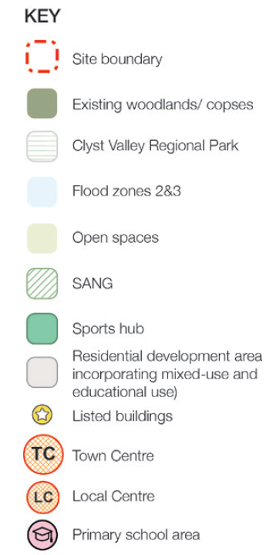
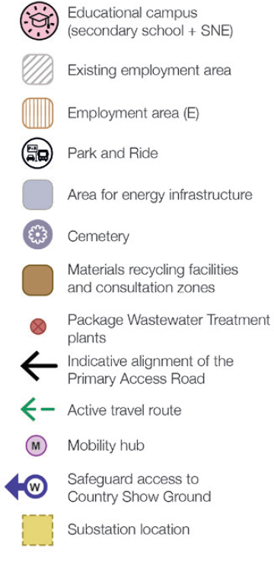
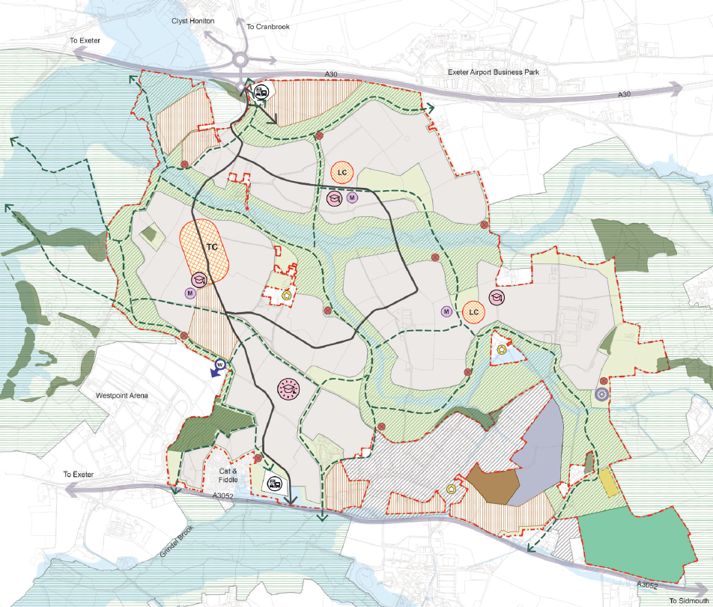
Marlcombe
Notes:
This slides shows the master plan for Marlcombe, which is part of a wider document setting out the story and the thinking behind it and a key document for the current stage of consultation.
This the final master plan for the consultation, although it is envisaged it will evolve over time, with feedback and as the proposals move forward.
Amongst other elements, the master plan shows:
the mix of uses - with a town centre at the centre of the master plan, and a series of neighbourhood centres, and schools. This includes a main through-school towards the south (from primary through to further education). This is high on the infrastructure list for early delivery, both as a hub/focal point for the community and given the absence of space within schools within the local area. There are also three further primary schools planned for within the settlement, a sports hub, and a range of employment spaces (north and south) and Park and Ride facilities (also north and south) - to enable people to transfer onto public transport and minimise trips going into the city from this point.
A road running north-south through the site as well as circular routes around the heart of the town to enable good circulation, including by public transport, to link the different neighbourhoods together.
a Country Park running through the settlement - picking up on one of the real attributes of Cranbrook and giving great access to natural open spaces close to people's homes, linking into the wider Clyst Valley Regional Park.
(Continued overleaf)

Slide 13
• The plan carries more weight now at final Reg 19 consultation. Council policy is now clearer
• No five-year housing land supply
• Tilted balance remains
• Protection for neighbourhood plans made less than 5 years ago that make an allocation
• We know sites are coming forward ahead of local plan adoption.
• Increasing weight may be given to requirements such as affordable housing, 20% BNG, etc
Current position and decision making?
Notes:
At this Regulation 19 stage, the plan is essentially the final version that the Council will be looking to submit for examination and therefore greater clarity that it represents Council policy moving forward. You will therefore see us starting to give significantly more weight to the emerging proposals in the plan in decision making, especially those which are less contentious. It cannot carry full weight until it has been examined and adopted, and there will almost certainly be changes along the way. In terms of new/different requirements it places on development e.g. about affordable housing, biodiversity net gain etc. and which are subject to significant representations of concern, particularly from the development industry, we cannot yet apply those policy requirements at this stage. In those instances, we will be relying on, for example, the established policies in the adopted local plan in terms of affordable housing and the national requirement for 10% biodiversity net gain presently - and moving to implement the new policies as the plan progresses to adoption.
It is also important to note that we do not have a five-year housing land supply (HLS) (although it is an improving situation, it currently stands at 3.5 years). The significance of this relates to the weight that can be given to adopted and emerging plan policy/strategy, and the balance of considerations in decision making. Without a full 5-year HLS, this balance is very much tilted in favour of enabling new housing development because of the insufficient supply of homes and not yet having an up-to-date local plan (although there is some protection for neighbourhood plans that have been made for less than five years and include an allocation.)
We appreciate that seeing sites that are allocated in the plan coming forward ahead of the plan naturally causes some concern and may seem the wrong way round, or even untoward. It is however not unusual for developers to submit applications ahead of the examination of the plan and for those to be determined, and there is full consultation on those applications and considering all of the views that are put forward in response. We also need to be able to demonstrate a full 5-year HLS at the point of plan adoption.

Slide 14
The Government (MHCLG) advise of the new consultation NPPF:
- Present national policy more clearly, so that it is accessible and understandable
- Make national policy more rules based, to improve consistency and predictability
- Make policy for decision-making more comprehensive, to support efforts to avoid duplication in plans
- Take further opportunities to support growth across different sectors.
Consultation closes - Tuesday 10 March 2026.
National changes looking forward
Notes:
At this Regulation 19 stage, the plan is essentially the final version that the Council will be looking to submit for examination and therefore greater clarity that it represents Council policy moving forward. You will therefore see us starting to give significantly more weight to the emerging proposals in the plan in decision making, especially those which are less contentious. It cannot carry full weight until it has been examined and adopted, and there will almost certainly be changes along the way. In terms of new/different requirements it places on development e.g. about affordable housing, biodiversity net gain etc. and which are subject to significant representations of concern, particularly from the development industry, we cannot yet apply those policy requirements at this stage. In those instances, we will be relying on, for example, the established policies in the adopted local plan in terms of affordable housing and the national requirement for 10% biodiversity net gain presently - and moving to implement the new policies as the plan progresses to adoption.
It is also important to note that we do not have a five-year housing land supply (HLS) (although it is an improving situation, it currently stands at 3.5 years). The significance of this relates to the weight that can be given to adopted and emerging plan policy/strategy, and the balance of considerations in decision making. Without a full 5-year HLS, this balance is very much tilted in favour of enabling new housing development because of the insufficient supply of homes and not yet having an up-to-date local plan (although there is some protection for neighbourhood plans that have been made for less than five years and include an allocation.)
We appreciate that seeing sites that are allocated in the plan coming forward ahead of the plan naturally causes some concern and may seem the wrong way round, or even untoward. It is however not unusual for developers to submit applications ahead of the examination of the plan and for those to be determined, and there is full consultation on those applications and considering all of the views that are put forward in response. We also need to be able to demonstrate a full 5-year HLS at the point of plan adoption.

Slide 15
Introduction of Spatial Development Strategies – Devon wide (harking back to Structure Plans?).
New slimmer and more speedily produced local plans.
Local plans to include far fewer policies (onus on reliance on NPPF policies).
Key focus for local plans to be on allocating land for development.
And … all within the context of local government reorganisation.
Longer term plan making
Notes:
At this Regulation 19 stage, the plan is essentially the final version that the Council will be looking to submit for examination and therefore greater clarity that it represents Council policy moving forward. You will therefore see us starting to give significantly more weight to the emerging proposals in the plan in decision making, especially those which are less contentious. It cannot carry full weight until it has been examined and adopted, and there will almost certainly be changes along the way. In terms of new/different requirements it places on development e.g. about affordable housing, biodiversity net gain etc. and which are subject to significant representations of concern, particularly from the development industry, we cannot yet apply those policy requirements at this stage. In those instances, we will be relying on, for example, the established policies in the adopted local plan in terms of affordable housing and the national requirement for 10% biodiversity net gain presently - and moving to implement the new policies as the plan progresses to adoption.
It is also important to note that we do not have a five-year housing land supply (HLS) (although it is an improving situation, it currently stands at 3.5 years). The significance of this relates to the weight that can be given to adopted and emerging plan policy/strategy, and the balance of considerations in decision making. Without a full 5-year HLS, this balance is very much tilted in favour of enabling new housing development because of the insufficient supply of homes and not yet having an up-to-date local plan (although there is some protection for neighbourhood plans that have been made for less than five years and include an allocation.)
We appreciate that seeing sites that are allocated in the plan coming forward ahead of the plan naturally causes some concern and may seem the wrong way round, or even untoward. It is however not unusual for developers to submit applications ahead of the examination of the plan and for those to be determined, and there is full consultation on those applications and considering all of the views that are put forward in response. We also need to be able to demonstrate a full 5-year HLS at the point of plan adoption.

Slide 16
Any questions?
Notes:
Question 1:
When do you see us getting - or can you see us getting - to having a five-year housing supply and how does that affect us if we don't get one?
Answer:
We must have a five-year housing land supply at the point of adoption of the new Local Plan. So in the meantime we do need to bolster our housing land supply through consents. This is part of the reason why you see sites coming forward ahead of the local plan and why where those comply with the emerging policy, we're looking to support them and bring them forward early to help to bolster that supply position such that when we get to the local plan examination, we can present trajectories that demonstrate a five year housing land supply and that therefore the plan is sound and we can deliver to meet the housing needs.
We are looking to achieve plan adoption towards the end of 2027/early 2028 and the target is therefore to achieve the full 5-year housing land supply by that point – we do not realistically envisage we are going to get to a five-year housing land supply before then.
Question 2:
As presumably, this is more led-by /down to landowners and developers putting schemes forward – what happens / how it be addressed if that is not the case?
Answer:
That is a factor, but in that respect we are fortunate in the sense that East Devon is a place where there is quite high demand for housing and developers do want to bring sites forward, even in market conditions which aren’t so favourable. In the last couple of years, the numbers that have been delivered have been around 600 homes per year - as opposed to the 950 that we've trying to achieve - but even so, we have seen quite significant consents coming forward in that timescale in terms of applications on sites that are allocated in the emerging plan and for the expansion areas at Cranbrook, which creating a pipeline of applications which will help to bolster our supply. We are confident that we can have reached the position we need to by the point of plan adoption, but we do not have any expectation that we will manage to do it before then.

